Slide 1


NNECL webinar:
The Impact of Trauma on Learning
Tuesday 18th March 2025

Slide 2

14
22%
71%
£660
60%
NNECL began as a volunteer network within the university widening participation space in 2013. We became a registered charity in 2018.
Together with our members who are embedded in post-16 education or leaving care teams, we are laser-focused on supporting, connecting and empowering professionals so more young people with care experience, who are estranged or who seeking sanctuary, consider, access and are supported to flourish through further and higher education, into fulfilling careers which will sustain them for life.
Our Quality Mark creates educational environments where our young people thrive.
NNECL Membership Options

Slide 3
Today we are joined by Dr Zoe Baker from University of Sheffield
Dr Zoe Baker is a Lecturer in Education specialising in issues of inequality and social justice in higher education. Her latest research explores inequalities in higher education access, progression, and outcomes for care experienced people. In addition to her research and teaching activities, Zoe volunteers as an Independent Visitor for children and young people in care with Sheffield City Council’s children's social care services.
14
22%
71%
£660
60%

Slide 5
Future Webinars;
Understanding Local Authority Data- 01/05/2025
Understanding the Quality Mark and the submission process- 13/05/2025
The vital connection between nutrition, mental wellbeing, and education for individuals in care - 21/05/2025
All opening for booking soon
14
22%
71%
£660
60%

Slide 6
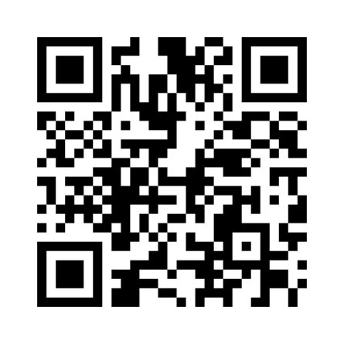
14
22%
71%
£660
60%
Quick evaluation
https://www.menti.com/aleuvk3kkttr

Slide 7
14
22%
71%
£660
60%
Thank you and keep in touch
LinkedIn
National Network for the Education of Care Leavers
Twitter / X
@_NNECL
Instagram
@nnecl__

