Slide 1

NNECL Webinar: Graduate transitions for care experienced students
Dr Zoe Baker FHEA
Helen Embleton Post Graduate Conversion Course Manager, Office for Students
Patricia Ambrose NNECL

Slide 2
Webinar Etiquette
For all attendees to have equal access to our slides and speakers please ensure that all videos and microphones are off and muted throughout the webinar.
Please be aware that we will be recording this webinar and sharing the recording on our website following the event.
There will be time at the end of today's webinar for questions so please use the chat function to ask your questions as they arise. We kindly ask that you do not respond to questions within the chat function.
We will be sending out slides, along with any questions and answers following the webinar.

Slide 3
Programme
Welcome, introduction and background- Patricia Ambrose, NNECL
Graduate outcomes for care-experienced students: What we know, and what is left to uncover– Dr Zoe Baker,
#JoinYourAIFuture – Scholarships for care experience students to study AI and Data Science – Postgraduate Conversion Course Manager, Helen Embleton, Office for Students

Slide 4
Introduction & background
This area of research and practice is of growing importance as the focus begins to shift beyond access to progression and success
NNECL’s feasibility study for OfS highlighted the importance of dedicated and consistent careers support throughout the care experienced student lifecycle and post-graduation
According to Propel website data, careers advice and support after graduation is the most cited support offered by just under 70% of providers
Aware of other research and activities in this area and we plan to feature some further work on this topic at a future webinar

Slide 5



Graduate outcomes for care-experienced students: What we know, and what is left to uncover
Dr Zoe Baker
zoesarahbaker@gmail.com
@zs_baker

Slide 6
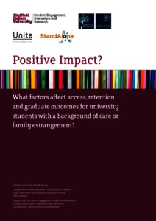
Introduction
‘Positive Impact’ (2018-2020): Mixed methods study which explored factors that affect access, retention and graduate outcomes for care experienced and estranged students.
Jacqueline Stevenson (University of Leeds), Zoe Baker (Sheffield Hallam), Neil Harrison (University of Oxford), Becca Bland (Stand Alone Charity).
Research literature in the areas of HE access and progression has been gradually growing since Jackson’set al.’s (2005) ‘By Degrees’ research…
Very little was known about CE graduate outcomes…until now!
Notes:
I have been researching fair access to HE for 11 years, with much of my earlier work focusing on socioeconomically underrepresented students.
Following the completion of my PhD from the University of Sheffield (which also focused on access to HE amongst underrepresented groups in HE), I wanted to focus specifically on care-experienced people. This was motivated by my own background as a care leaver.
In 2018, I joined colleagues Jacqueline Stevenson (University of Leeds), Neil Harrison (University of Oxford) and Becca Bland (Stand Alone Charity) to undertake a research project titled ‘Positive Impact’, where we explored CE and estranged students’ HE access, progression and outcomes nationally– commissioned by the Unite Foundation. This was a mixed methods study – my work focused on the qualitative strand where I undertook interviews with CE students, and HE staff. Neil Harrison undertook all of the statistical analysis for the project – the data I will be showing shortly is all from his analysis. Research literature in the areas of HE access and progression has been gradually growing since Jackson’s (2005) ‘By Degrees’ research…and we have also contributed to that body of research with the Positive Impact work. We also extended it into CE graduate outcomes – an area where there is very little research knowledge at the moment. I was also particularly drawn to this We have started publishing our findings around this aspect of the research recently, and I will talk about the key headline findings from this before highlighting what is left to uncover, and my future research plans to uncover this.

Slide 7
Where do care-experienced graduates go?
Analysis of 2016/17 Destination of Leavers from Higher Education (DLHE) dataset (Harrison, Baker & Stevenson, 2020)
Care-experienced graduates were somewhat less likely than their peers to be in professional roles 6 months after graduation (63.7,% compared to 68.5%).
Were disproportionately likely to be working in public administration, social work and residential care.
Salary profiles between care-experienced and other graduates were almost identical.
Significantly more likely to progress to postgraduate study than non-CE peers (25.3%, compared to 21.4%) (Baker, Harrison, Stevenson & Wakeling, forthcoming)
Notes:
These are the key headline findings from Neil’s analysis of the 2016/17 DLHE dataset. We go into much more depth in our recent paper on CE graduate outcomes published in 2020 (see hyperlinked) as well as a forthcoming paper focusing on CE progression to postgraduate study both in terms of the t stats, and also the possible underpinning explanations for these stats.
Less likely to be in professional employment:
We caution in our paper that the 6 month picture offered by the DLHE data may not be ideal, as many graduates are ‘finding their feet’ during this time.
Additionally, I highlighted in this paper that CE graduates are less likely to have family homes to return to after graduation while trying to locate professional employment (‘yo-yo transitions’) and therefore may have fewer ‘safety nets’ of family support (financial or otherwise) meaning that they are under more pressure to find work – any work – as quickly as possible after graduation.
This was also indicated in the interviews I undertook with CE students as part of the Positive Impact work, with those close to graduation feeling pressure to find any source of income quickly – the luxury of waiting for a ‘professional’ opportunity to arise was often not afforded to them.
Types of work:
In the qualitative strand of the research, CE students explained that they were drawn to professions where they could help others or improve systems for others (such as social work) which could explain this. They were often very altruistically motivated.
PG study:
I have proposed many potential reasons for this in my forthcoming paper – too many to cover in depth here! Yet the key ones are:
The introduction of Master’s loans open up opportunities for all students to progress to PG study.
Professions such as social work, and health related professions, often require a Master’s degree.
The absence of family safety nets may lead to CE students to extend the relative sense of safety and stability that HE offers them (those I interviewed spoke about how HE was a safe and stable option).
To increase their employability, particularly since CE students who progressed to PG study were those who had lower degree outcomes (2.2s). Hence, getting a PG degree may have been a way to protect against a lower UG degree outcome when seeking employment.

Slide 8

What is left to uncover?
We now have quantitative understandings of CE graduate destinations.
From this, along with existing research literature into CE transitions generally, we can propose potential explanations for these statistics.
Yet, we do not know the ‘why’…
Future research plans
Qualitative exploration of CE students’ transitions into graduate life will:
Provide insights into the ‘why’ behind these findings.
Establish understandings of the structural challenges faced by CE graduates (what, if anything, did they need to negotiate to arrive at their destinations?)
Status: Awaiting funding outcomes!
Notes:
We now have quantitative understandings of CE graduate destinations.
From this, along with existing research literature into CE transitions generally, we can propose potential explanations for these statistics – as I have just done so on the previous slide, as well as in our publications. Some of this insight was also understandably informed by my own background as a care leaver.
We do not know the why behind these stats though.

Slide 9
References
Baker, Z., Harrison, N., Stevenson, J. & Wakeling, P. (forthcoming) Patterns of postgraduate transitions amongst care-experienced graduates in the United Kingdom.
Harrison, N., Baker, Z. & Stevenson, J. (2020) Employment and further study outcomes for care-experienced graduates in the UK. Higher Education.
Jackson, S., Ajayi, S., & Quigley, M. (2005) Going to university from care. London: University of London.
Stevenson, J., Baker, Z., Harrison, N., Bland, B., Jones-Devitt, S., Donnelly, A., …Austen, L. (2020) Positive impact? What factors affect access, retention and graduate outcomes for university students with a background of care or family estrangement? Bristol: The Unite Foundation.

Slide 10
Postgraduate Conversion Courses in AI and Data Science
National Network for the Education of Care Leavers
Helen Embleton, Postgraduate Conversion Course Programme Manager
Tuesday 11 May 2021
#JoinYourAIFuture

Slide 11



Government policy
Growing the Artificial Intelligence Industry

Slide 12
Programme objectives
Accelerate the number of highly skilled graduates in AI and data science by 2500 by 2023
Diversify the AI and data science workforce by funding 1000 scholarships for underrepresented groups, particularly Black students, women and disabled students
Attract students from Science, Technology, Engineering and Maths (STEM), far-STEM and non-STEM disciplines

Slide 13
What is a conversion course?

Slide 14

Scholarships
£10,000 scholarships for 1000 eligible students
Women
Black students
Students registered disabled
Students from POLAR Q1 and Q2
Care experienced students
Estranged students
Gypsy, Roma, Traveller
Refugees
Children from military families, veterans and
partners of military personnel

Slide 15


Other benefits
Paid work placements
Flexible modes of delivery

Slide 16


Postgraduate
Conversion Course
Programme
Follow us on Twitter #JoinYourAIFuture
#JoinYourAIFuture

Slide 17
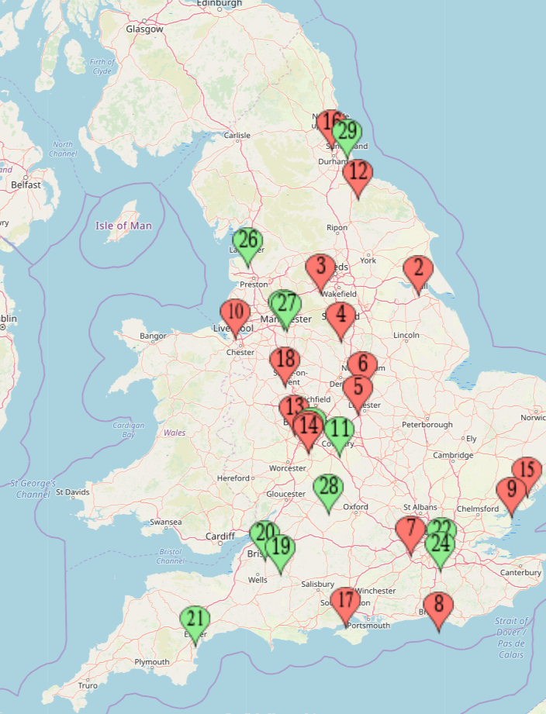
Providers offering courses
University of Keele
Solent University
Newcastle University
Birmingham City University
University of Wolverhampton
Loughborough University
University of Bradford
Teesside University
University of Birmingham
Nottingham Trent University
University of Suffolk
University of Liverpool
Brunel University London
University of Sussex
University of Essex
University of Hull
Sheffield Hallam University
Coventry University, on behalf of the Institute of Coding
Aston University
University of Bath
Birkbeck, University of London
University of Exeter
University of Gloucestershire
Lancaster University
Manchester Metropolitan University
Queen Mary University of London
University of Sunderland
University of the West of England

Slide 18
Any questions? Find out more
https://www.officeforstudents.org.uk/for-students/study-artificial-intelligence-and-data-science-as-a-postgraduate/
#JoinYourAIFuture

Slide 19
QUESTIONS TO THE PANEL
Please use the chat function to ask your questions to the panel.
Our panel consists of:
a FHEA
Dr Zoe Baker
Helen Embleton Postgraduate Conversion Course Manager, Office for Students

Slide 20
Future Webinars
We will be offering Bi-Monthly Webinars over the academic year. We will share details via our newsletters, Twitter, Bulletins and our website: https://nnecl.org/resources/nnecl-webinar-series-open-for-bo?topic=guides-and-toolkits

Slide 21
Thank you
Thank you for attending our webinar, we hope that you have found this session useful and informative.
NNECL very much values any feedback and input from our network, so please do contact us with anything: info@nnecl.org
Become a NNECL member for 2020/21 NNECL MEMBERSHIP

