Slide 1


Operations & Network Co-Ordinator
July 2026

Slide 2
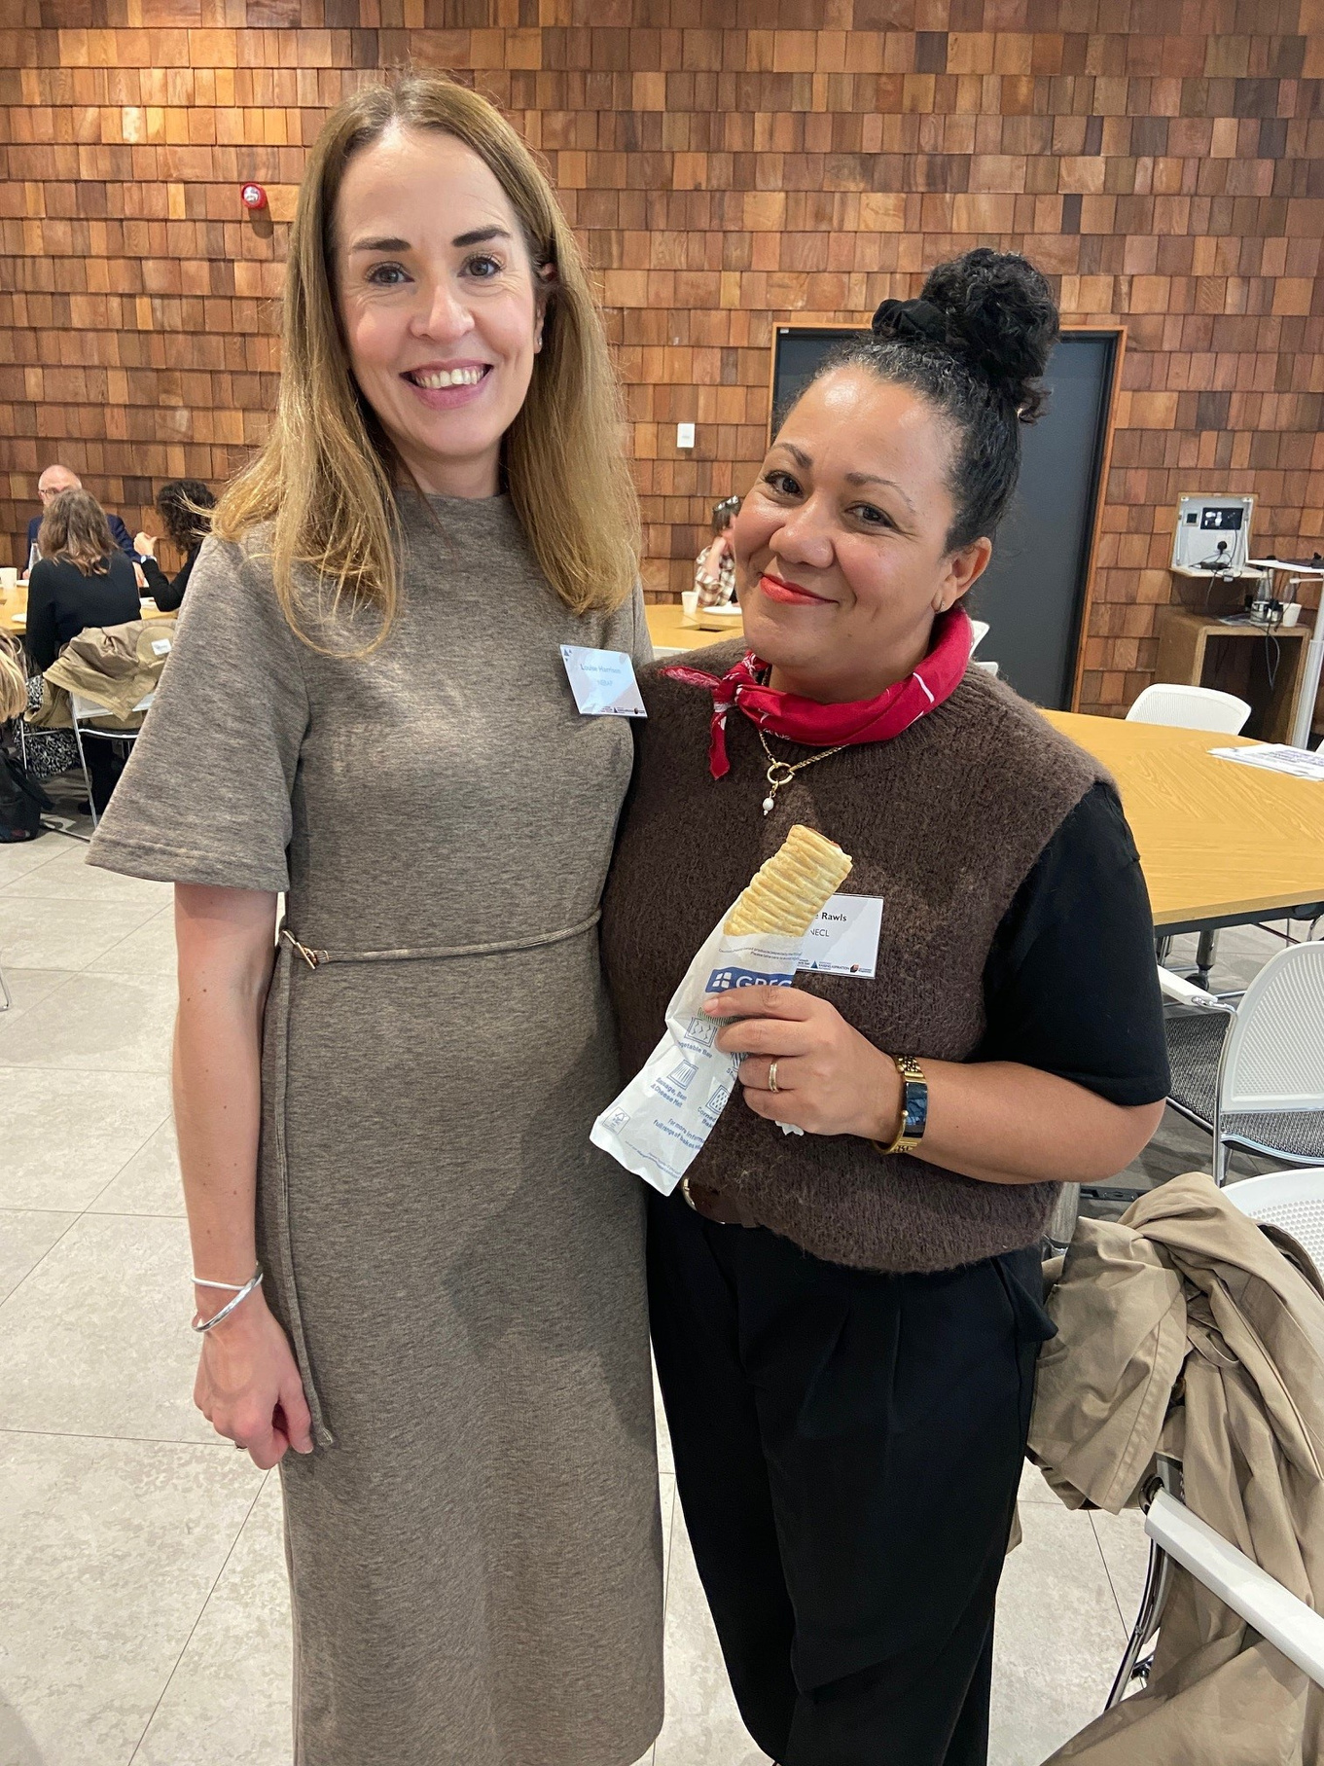

Hello,
Thank you for your interest in joining us as our new Operations and Network Co-Ordinator.
These few pages will tell you a bit more about us at NNECL and are written to support the Job Description, not replace it.
If you would like to have a conversation ahead of submitting your application please email info@nnecl.org
We know through this recruitment process we will meet many people who we would like to employ, sadly we can only hire one person. However, we do commit to responding to everyone who applies for the job, and we are happy to give feedback on applications and interviews. Over the years we have supported many people who we didn’t employ, into other roles.
We are looking forward to reading your application,

Slide 3

What problem are we solving?
Across the UK, care leavers are identified as a priority group for targeted outreach and support within universities and colleges to drive up educational attainment and to reduce the incidence of homelessness, poor mental health and under employment. Just 15% of care leavers enter higher education by the age of 19, compared to 48% of the general population. The reasons for this are complex and multi-layered.
  The impact of early childhood trauma
  The stark difference in attainment between children in care and their peers
  Disrupted education, sometimes involving several placements and school moves
  Low expectations from key influencers in a young person’s network; social workers, teachers, foster carers, sports coaches, youth workers and staff in leaving care teams

Slide 4
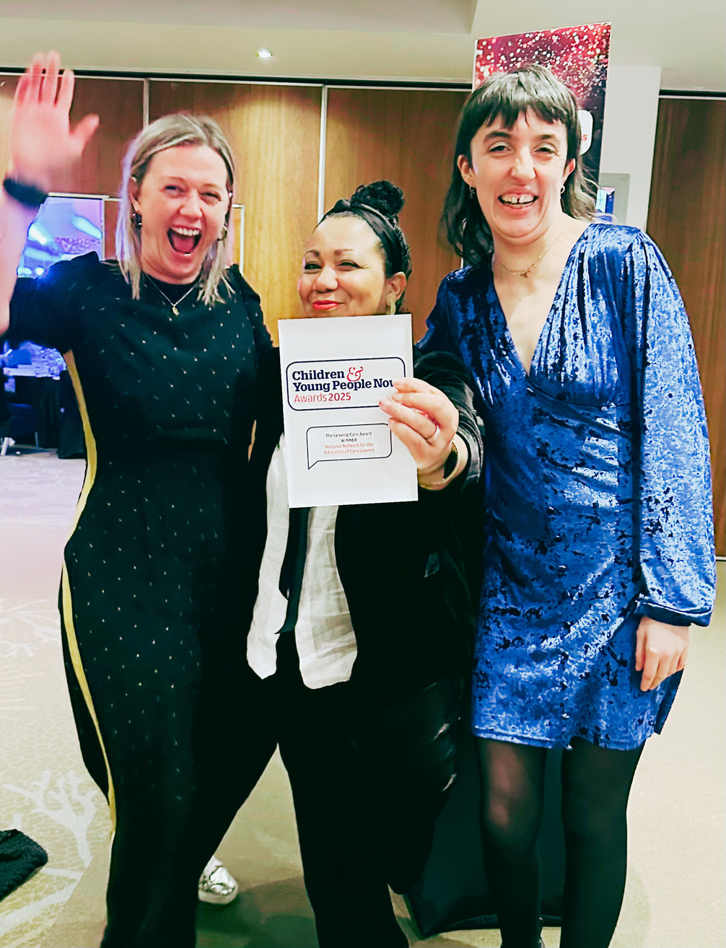
About NNECL ...
NNECL is an award winning not for profit organisation working across the UK, supporting, connecting, and empowering a community of practitioners with whom we share our overarching ambition, for more vulnerable young people from care backgrounds or who are estranged, to consider, access and flourish through apprenticeships, further and higher education into fulfilling careers, which will sustain them for life. By improving national co-ordination, collaboration and through our Quality Mark, NNECL aim to reduce the differences in educational support our young people typically experience.
Our vision is for learners with care experience across our four nations to be empowered and supported to achieve their full educational potential.
Our mission is to create educational environments where care- experienced and estranged learners thrive.

Slide 5
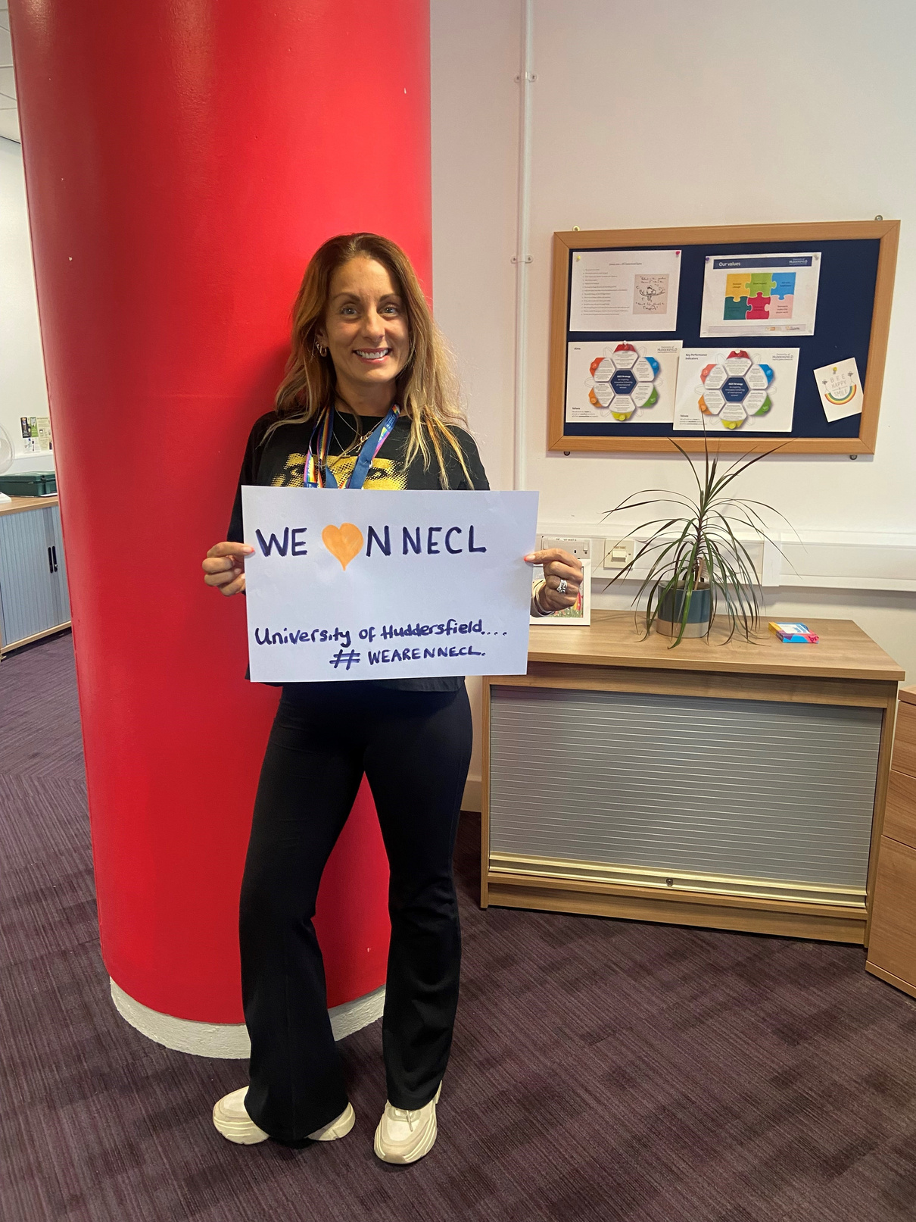
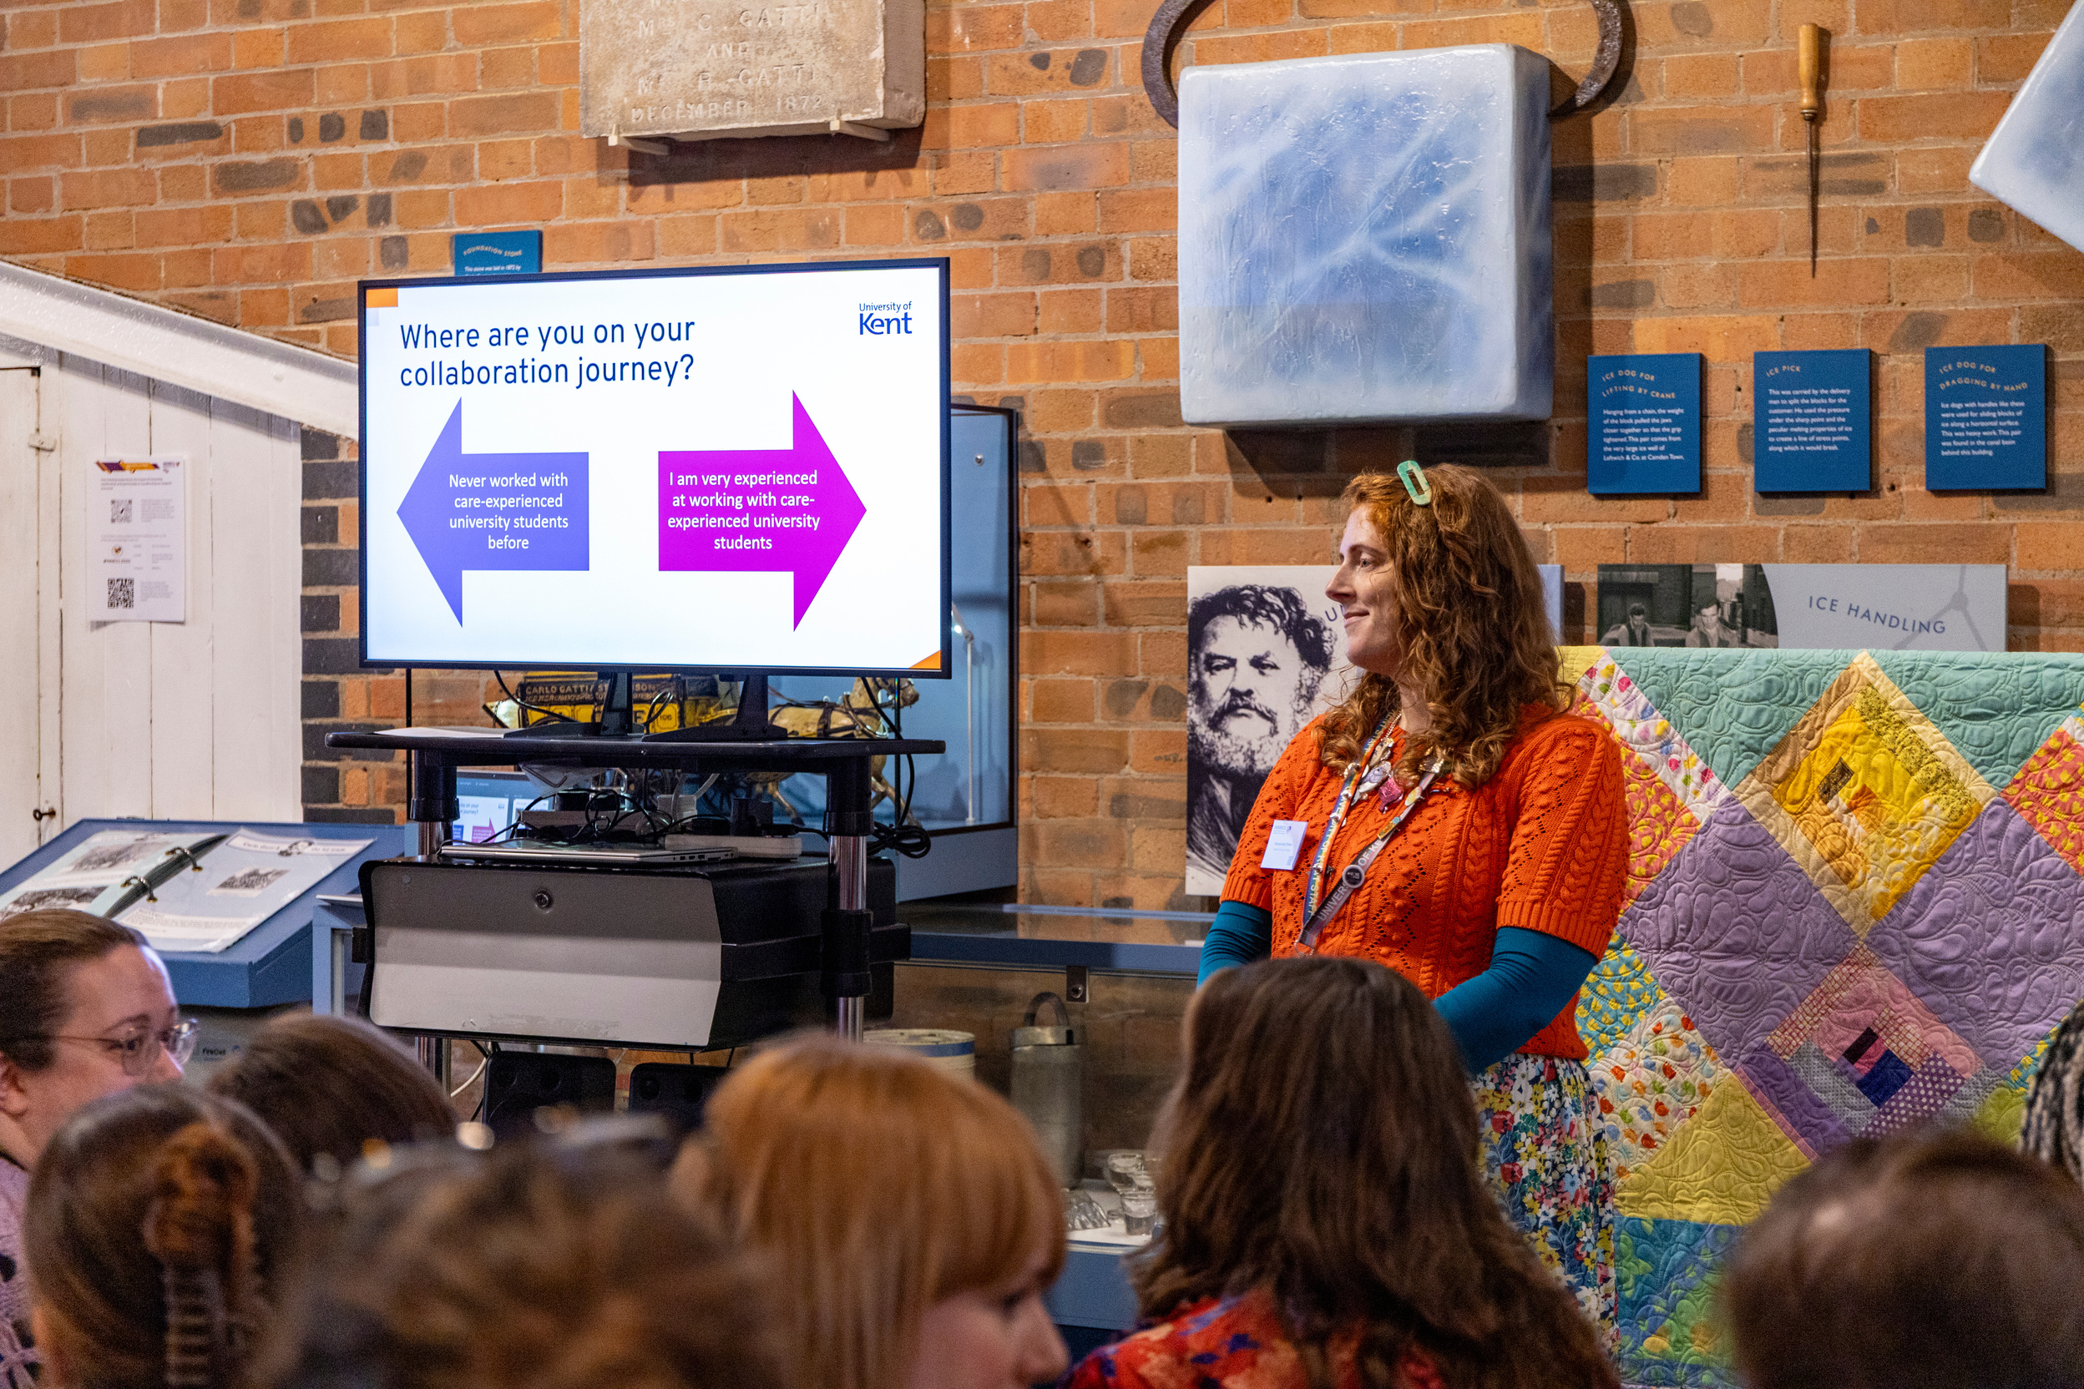
About NNECL ...
Established in 2018, NNECL is the only charity in the UK solely dedicated to transforming care leavers educational attainment. We are a membership body with over 100 organisations in active membership, including universities and colleges, foster agencies, local authority leaving care teams, virtual schools and charities.
Through our membership and strategic partnerships, we are proud to reach a community of more than 800 professionals who participate in our events and benefit from our regular policy and practice updates so they can best support the 5000+ care-experienced and estranged learners attending their institutions.
We independently generate our income through membership, training and consultancy, Quality Mark assessment fees, donations, and grants. We do not hold property or endowment funds and receive no core funding from central government.
NNECL members Ruth (L) (University of Huddersfield and Shauna (R) (University of Kent)

Slide 6
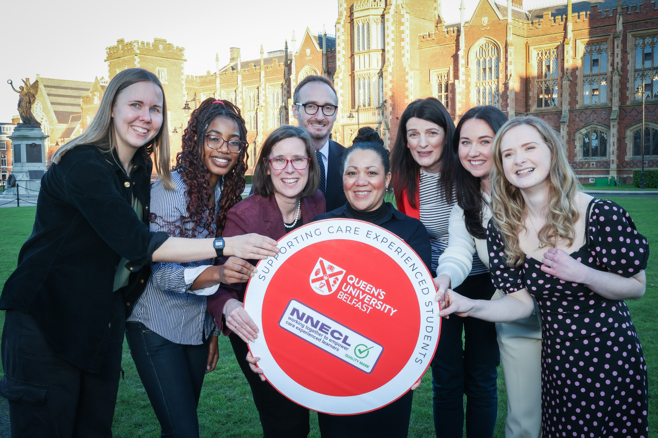

Our impact
We are incredibly proud of our Quality Mark, endorsed by the Department for Education and described by the sector as “gold standard.” To achieve it universities and colleges must evidence the holistic and practical support they provide to care-experienced and estranged learners and the impact and outcomes of their actions, including: a designated contact, financial bursaries, well-being and pastoral care, help with accommodation, work placements, careers guidance, progression rates and attainment. All Quality Mark submissions are peer reviewed by a panel of widening participation experts to ensure consistency. In November 2025 we announced University of Cambridge as our 50th Quality Mark holder.
Queens University Belfast receiving their Quality Mark accreditation

Slide 7



















A few of our members

Slide 8
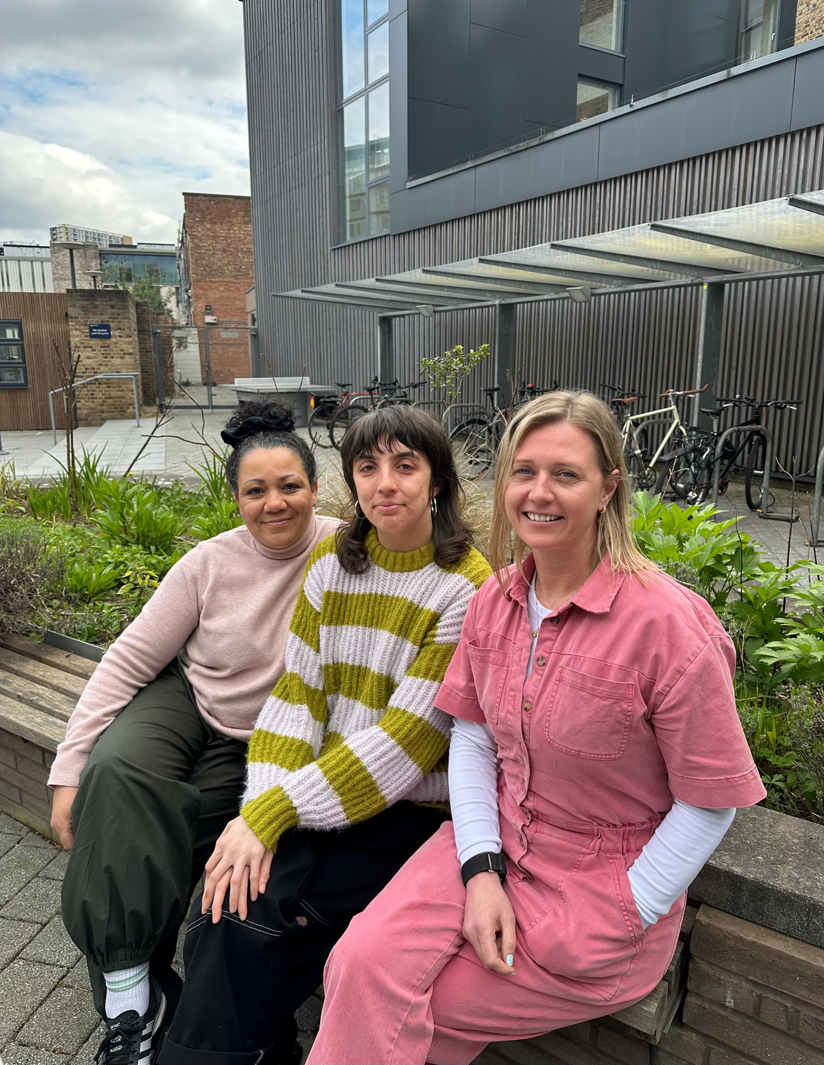
Our team
We employ three people full-time in our core team - our Executive Director, our Programme Manager and a Operations and network Co-Ordinator. Close-knit and collaborative, we bring together our professional skills, our lived experienced of care, and our dedication to support the people who guide our learners every day and help make a real difference in their educational journeys.
We have a team of freelance Quality Mark Assessors. With backgrounds spanning a wide range of roles supporting young people’s educational journeys. Our Assessors bring valuable knowledge and practical understanding to each Quality Mark submission.
Our National Strategy Group (NSG) is the central forum for communication across our eight Regional Groups. The NSG membership is made up of Regional Group representatives and national organisations committed to the progression and support of care-experienced young people through apprenticeships, further and higher education.
L – R Denise, Shaunna and Sian

Slide 9
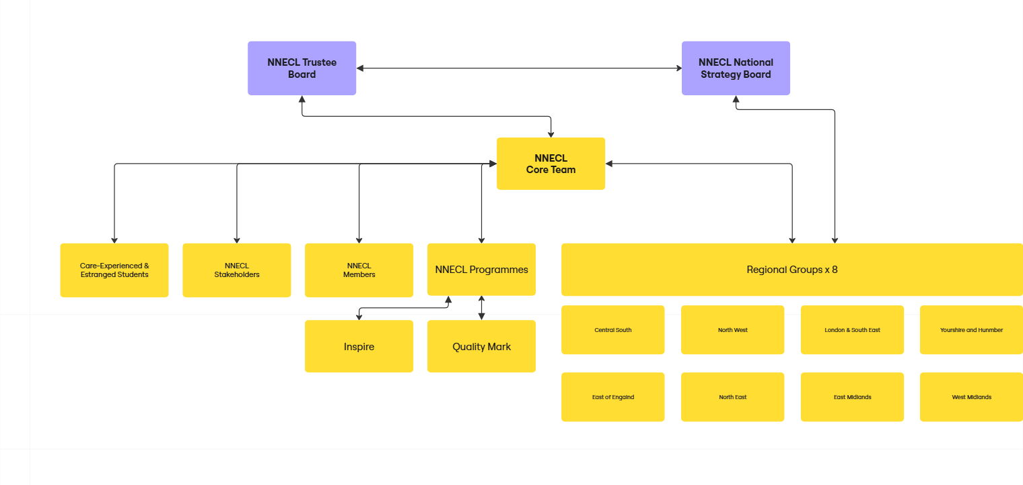
NNECL on a page

Slide 10
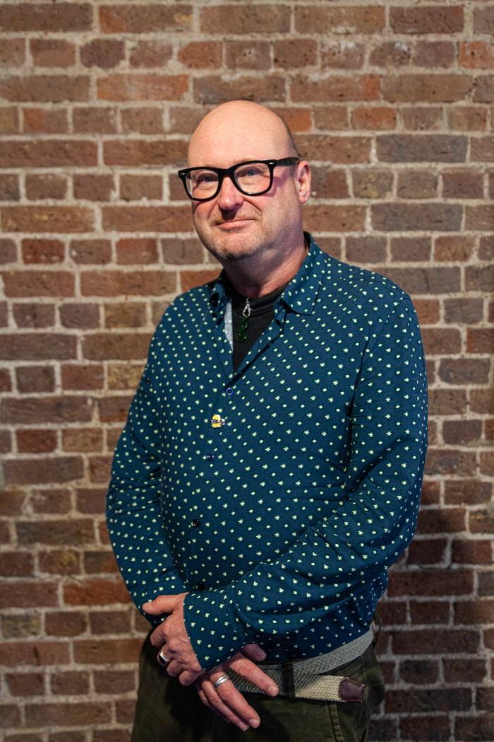
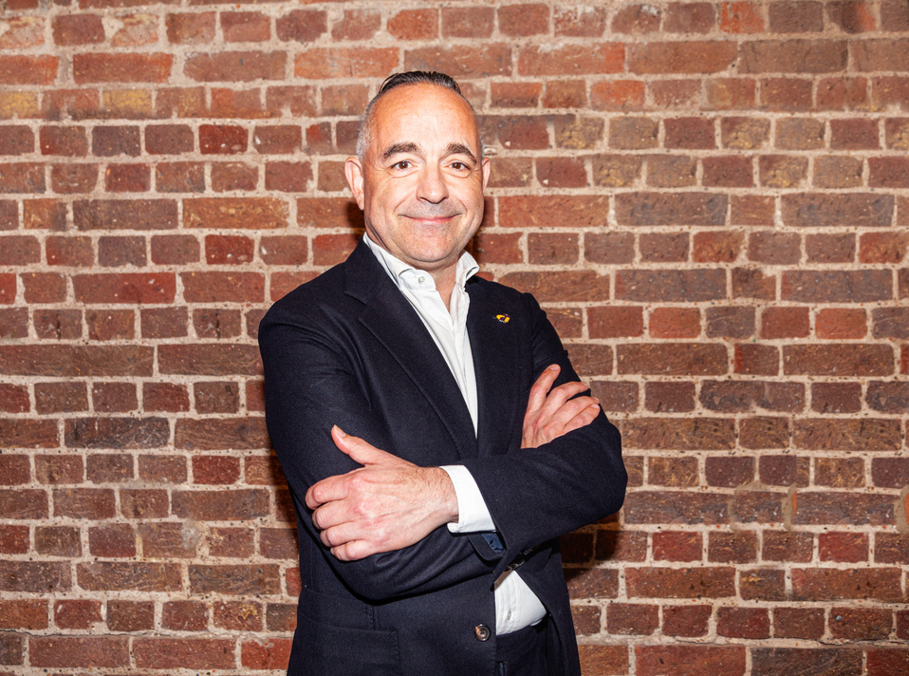
Our Trustees
We have seven Trustees, who meet a minimum of four times per year. Our Board is responsible for ensuring NNECL’s resources and activities are focused on addressing our charitable purpose. Its membership reflects the need to operate effectively at an organisational leadership level. We also have independent advice from our accountants. Our Board of Trustees are duty-bound to ensure NNECL complies with all legal and statutory requirements.
Arron Pile, Co-Chair of NNECL
Arron is Student Inclusion & Diversity Manager at the University of Salford. He has been involved in supporting care experienced young people (as well as estranged students, carers, sanctuary seekers and under eighteen students, trans and non-binary students), into and through higher education at the University of Salford for the last fifteen years. Arron has been involved in NNECL since its inception He has close relationships with Greater Manchester local authorities and provides foster care training and specialist training for people working around care experienced young people.
Jon Wakeford, Co-Chair of NNECL
Jon was appointed Co-Chair of NNECL in 2023. He has more than 25 years’ experience in the higher education sector and has held Board positions in several large-listed property and infrastructure businesses, including most recently leading strategy and communications at the University Partnerships Programme, the UK’s leading provide of campus accommodation and infrastructure, where he originated the Company’s approach to partnerships and
played a key role in the establishment of the Group’s bond programme and the
acquisition by its current shareholders.

Slide 11
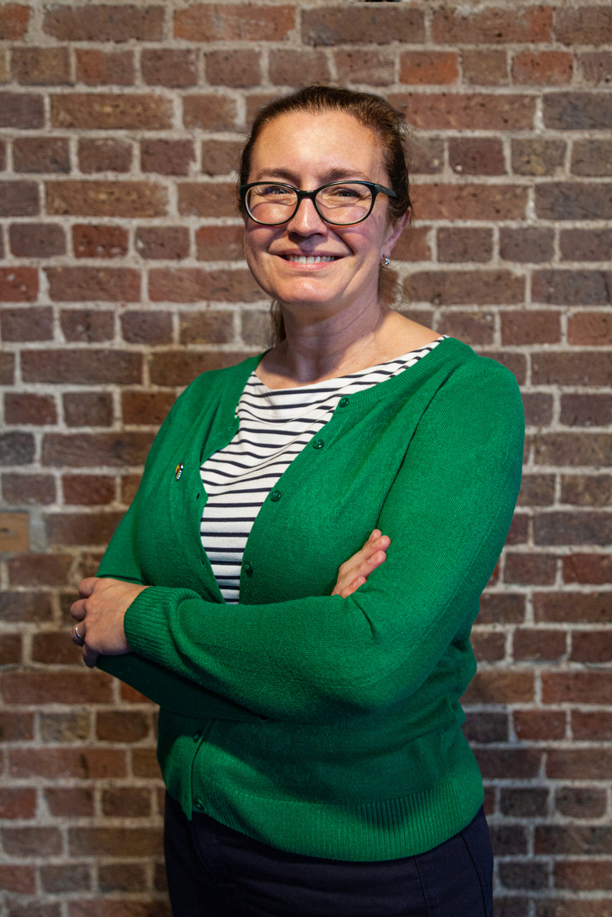
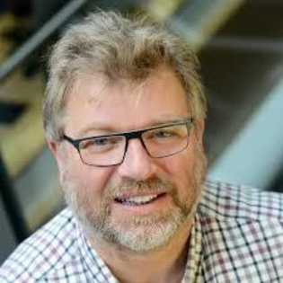
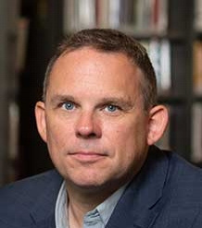
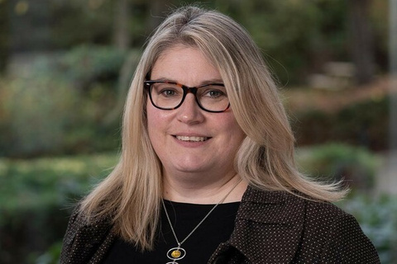
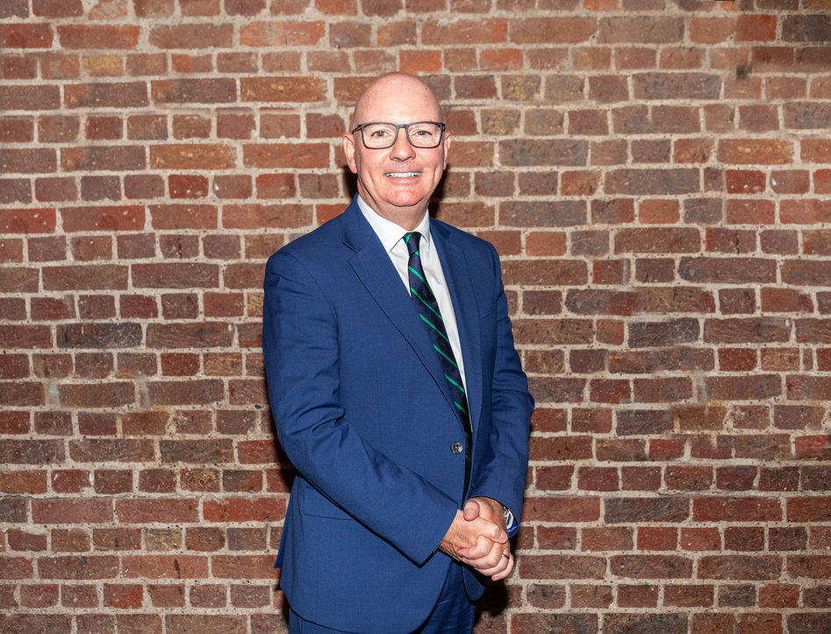
Emma Watson is NNECL’s Treasurer as well as a Trustee. She is a Chartered Financial Planner and has held numerous senior roles in Finance including heading up a large Financial Planning team for a UK bank.
Mike Hill has over 35 years experience of working in the Adult, Further and Higher Education sector. His areas of interest include widening access, student retention and success, student engagement and institutional research.
Dr Neil Harrison is Associate Professor in Education and Social Justice in the Graduate School of Education, University of Exeter. Neil was the author of NNECL’s ‘Moving on Up’ report the first examination of care leavers pathways into and through higher education.
Nicola Turner is a Adviser Engagement Partner at UCAS, where she works to support the supporters of under-represented students, including care-experienced and estranged students. She has worked in widening access and participation since joining UCAS in 2016.
Alan Benvie was until recently Vice Principal - Student Experience & Inclusion at Oldham College. He led the college's successful submission of the Quality Mark. He has over 30 years of successfully leading change programmes in post-16 education and training.

Slide 12
Appointments are made subject to following, which is inline with our recruitment policy
Thank you so much, we look forward to hearing from you.
  A formal interview and role competency test
  Satisfactory references
  A Right to Work check
  An employment history check
  A declaration of any interests you hold
Our charity number is 1180793. You can learn more about us via our website NNECL.ORG and by reading our annual report and accounts which are published on the Charities Commission website.

