Slide 1





Slide 2


In December 2025 Minister MacAlister and Minster Smith wrote to all Vice Chancellors in England asking them to review the support they offer for care leavers and consider a range of measures to drive up access and attainment, including undertaking our Quality Mark.

Slide 3



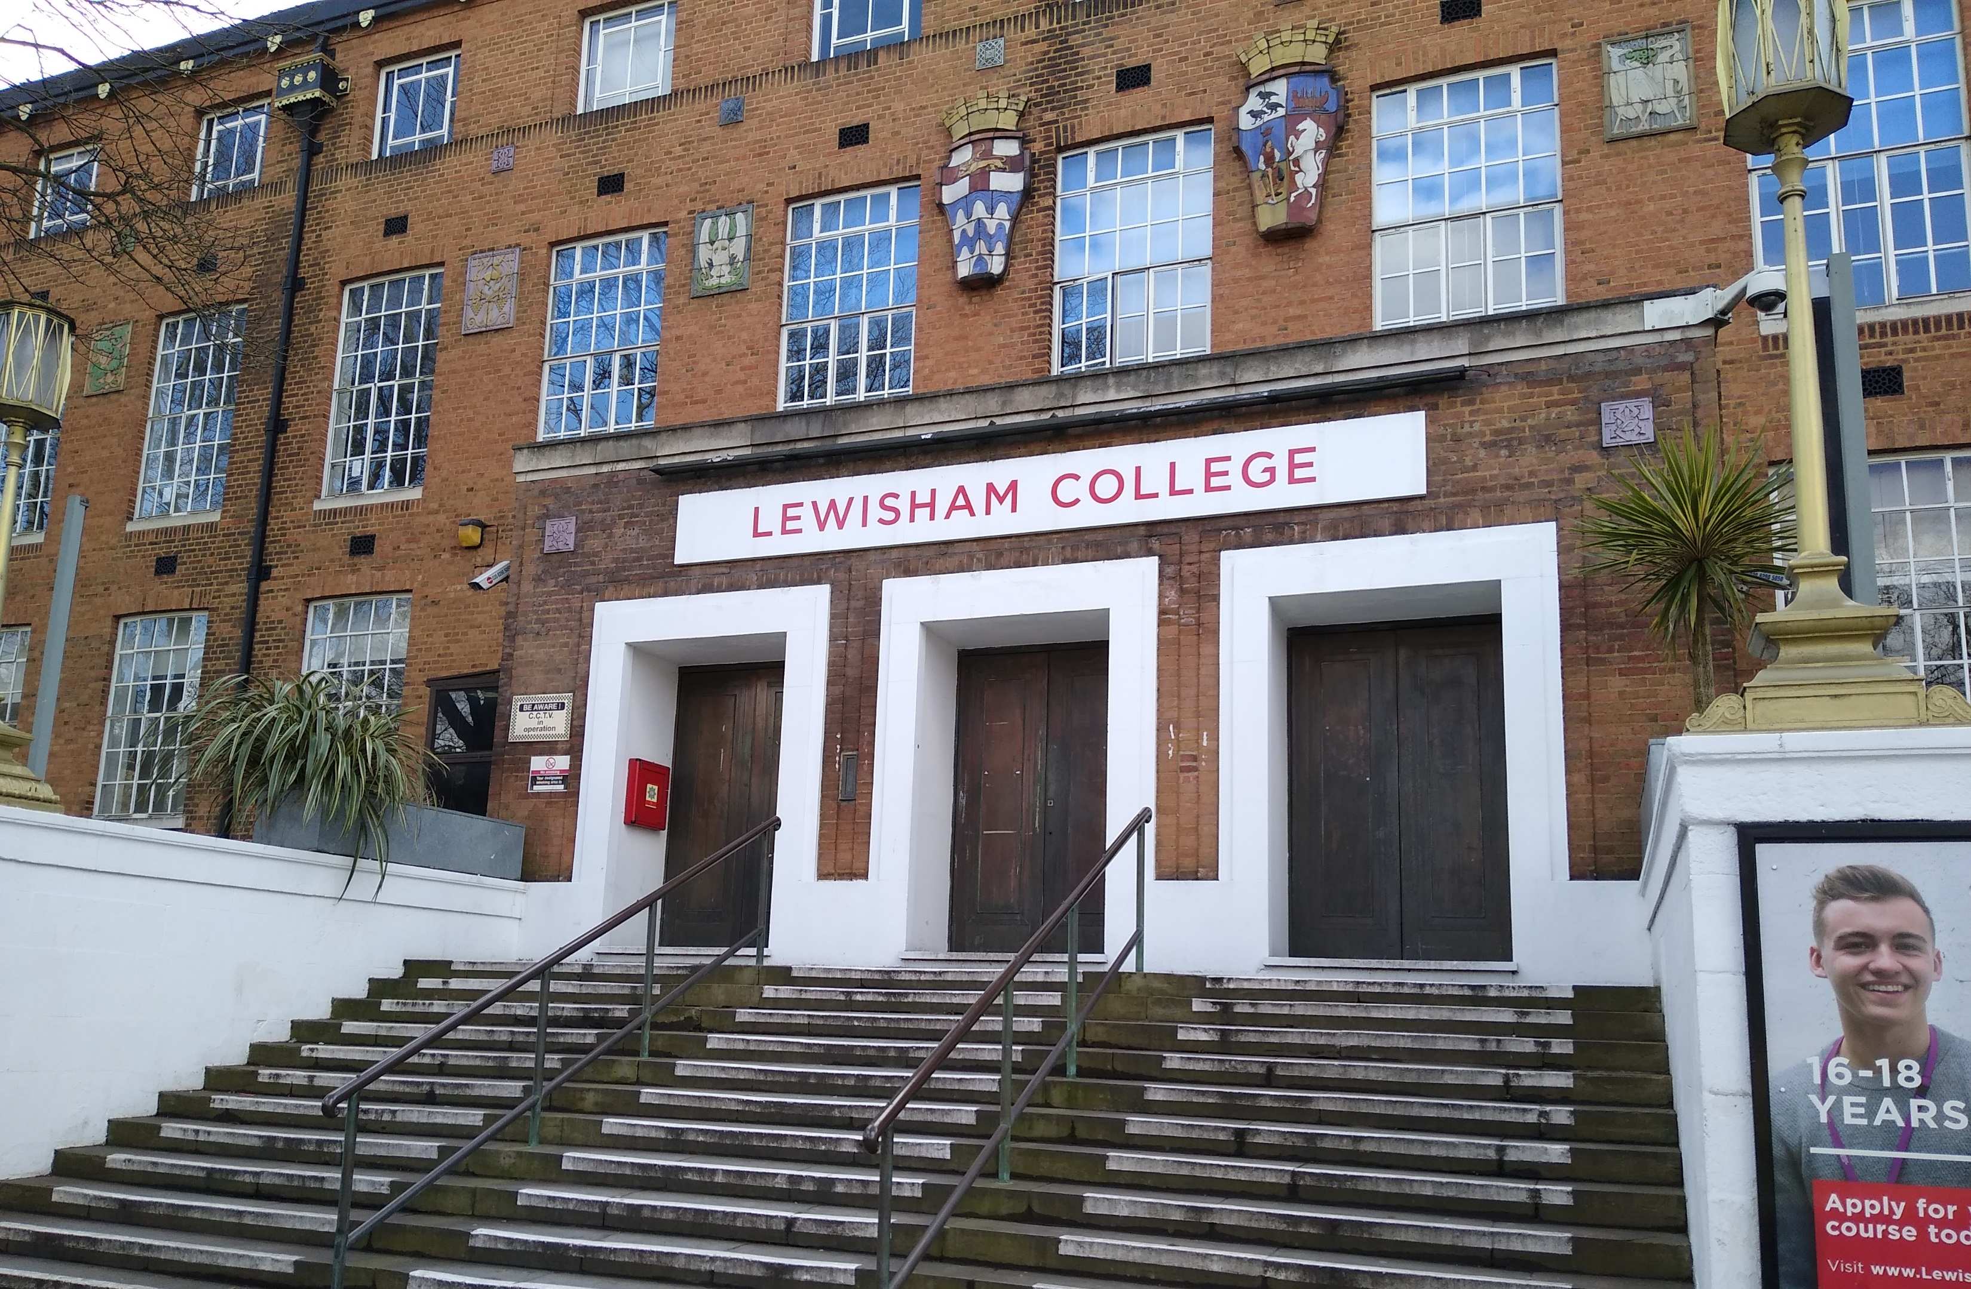
50 Quality Marks awarded: in FE
Bolton College
Bury College
Carlisle College
Exeter College
Hopwood Hall College
Kidderminster College
Leeds City College
Lewisham College
Newcastle 6th Form College
Newcastle College
Oldham College
Oldham Sixth Form College
Southwark College
St John Rigby College
The Manchester College
Trafford College Group
West Lancashire College
Wigan & Leigh College
Wirral Met College
Xaverian College

Slide 4

50 Quality Marks awarded: in HE
City St George's, University of London
De Montfort University
Edge Hill University
Kingston University
Liverpool John Moores University
Manchester Metropolitan University
Oxford Brookes University
Queen Mary University London
Queens University Belfast
Royal Central School of Speech and Drama
University of Bath
University of Bedfordshire
University of Bedfordshire
University of Birmingham
University of Bradford
University of Bristol
University of Cambridge
University of Exeter
University of Law
University of Leicester
University of Lincoln
University of Liverpool
University of Manchester
University of Nottingham
University of Salford
University of Sheffield
University of Sunderland
University of Wolverhampton
University of York
Grace Mpeso and Lucy Lanfear
Oxford Brookes University

Slide 5

The Quality Mark operates around 7 areas, covering the whole student lifecycle, culture/leadership, collaboration & partnership, plus ongoing evaluation and response.
Proportionate and contextualised, reflecting diversity of institutions across HE/FE and the different policy contexts across the UK.
Awarded for 3 years with mid-point review of action plan.
Is undertaken voluntarily by NNECL members.
A Sticky Campus sits in the 'Student Wellbeing' section of the Quality Mark, along with provision for physical and mental wellbeing and financial support.

Slide 6

We’ve moved beyond bursaries
The challenges preventing young people with care and estranged backgrounds achieving good education outcomes have been well researched over the last 20 years.
Life on campus is part of a complex discussion in keeping our young people from withdrawing from their studies.

Slide 7

Jonathan Batty and Ross Wilkinson- Durham University

Slide 8
How do we create a ‘sticky campus’ for EaCE+ students?

Slide 9
The need for change

Slide 10
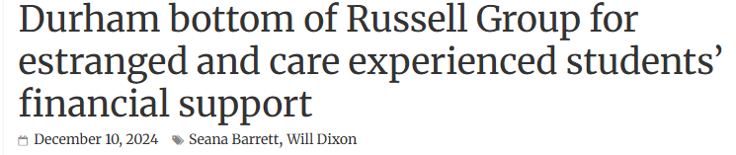
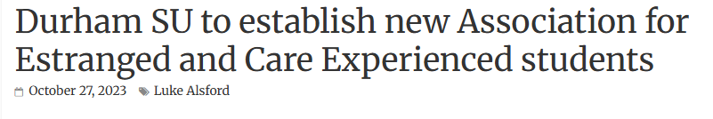


Slide 11

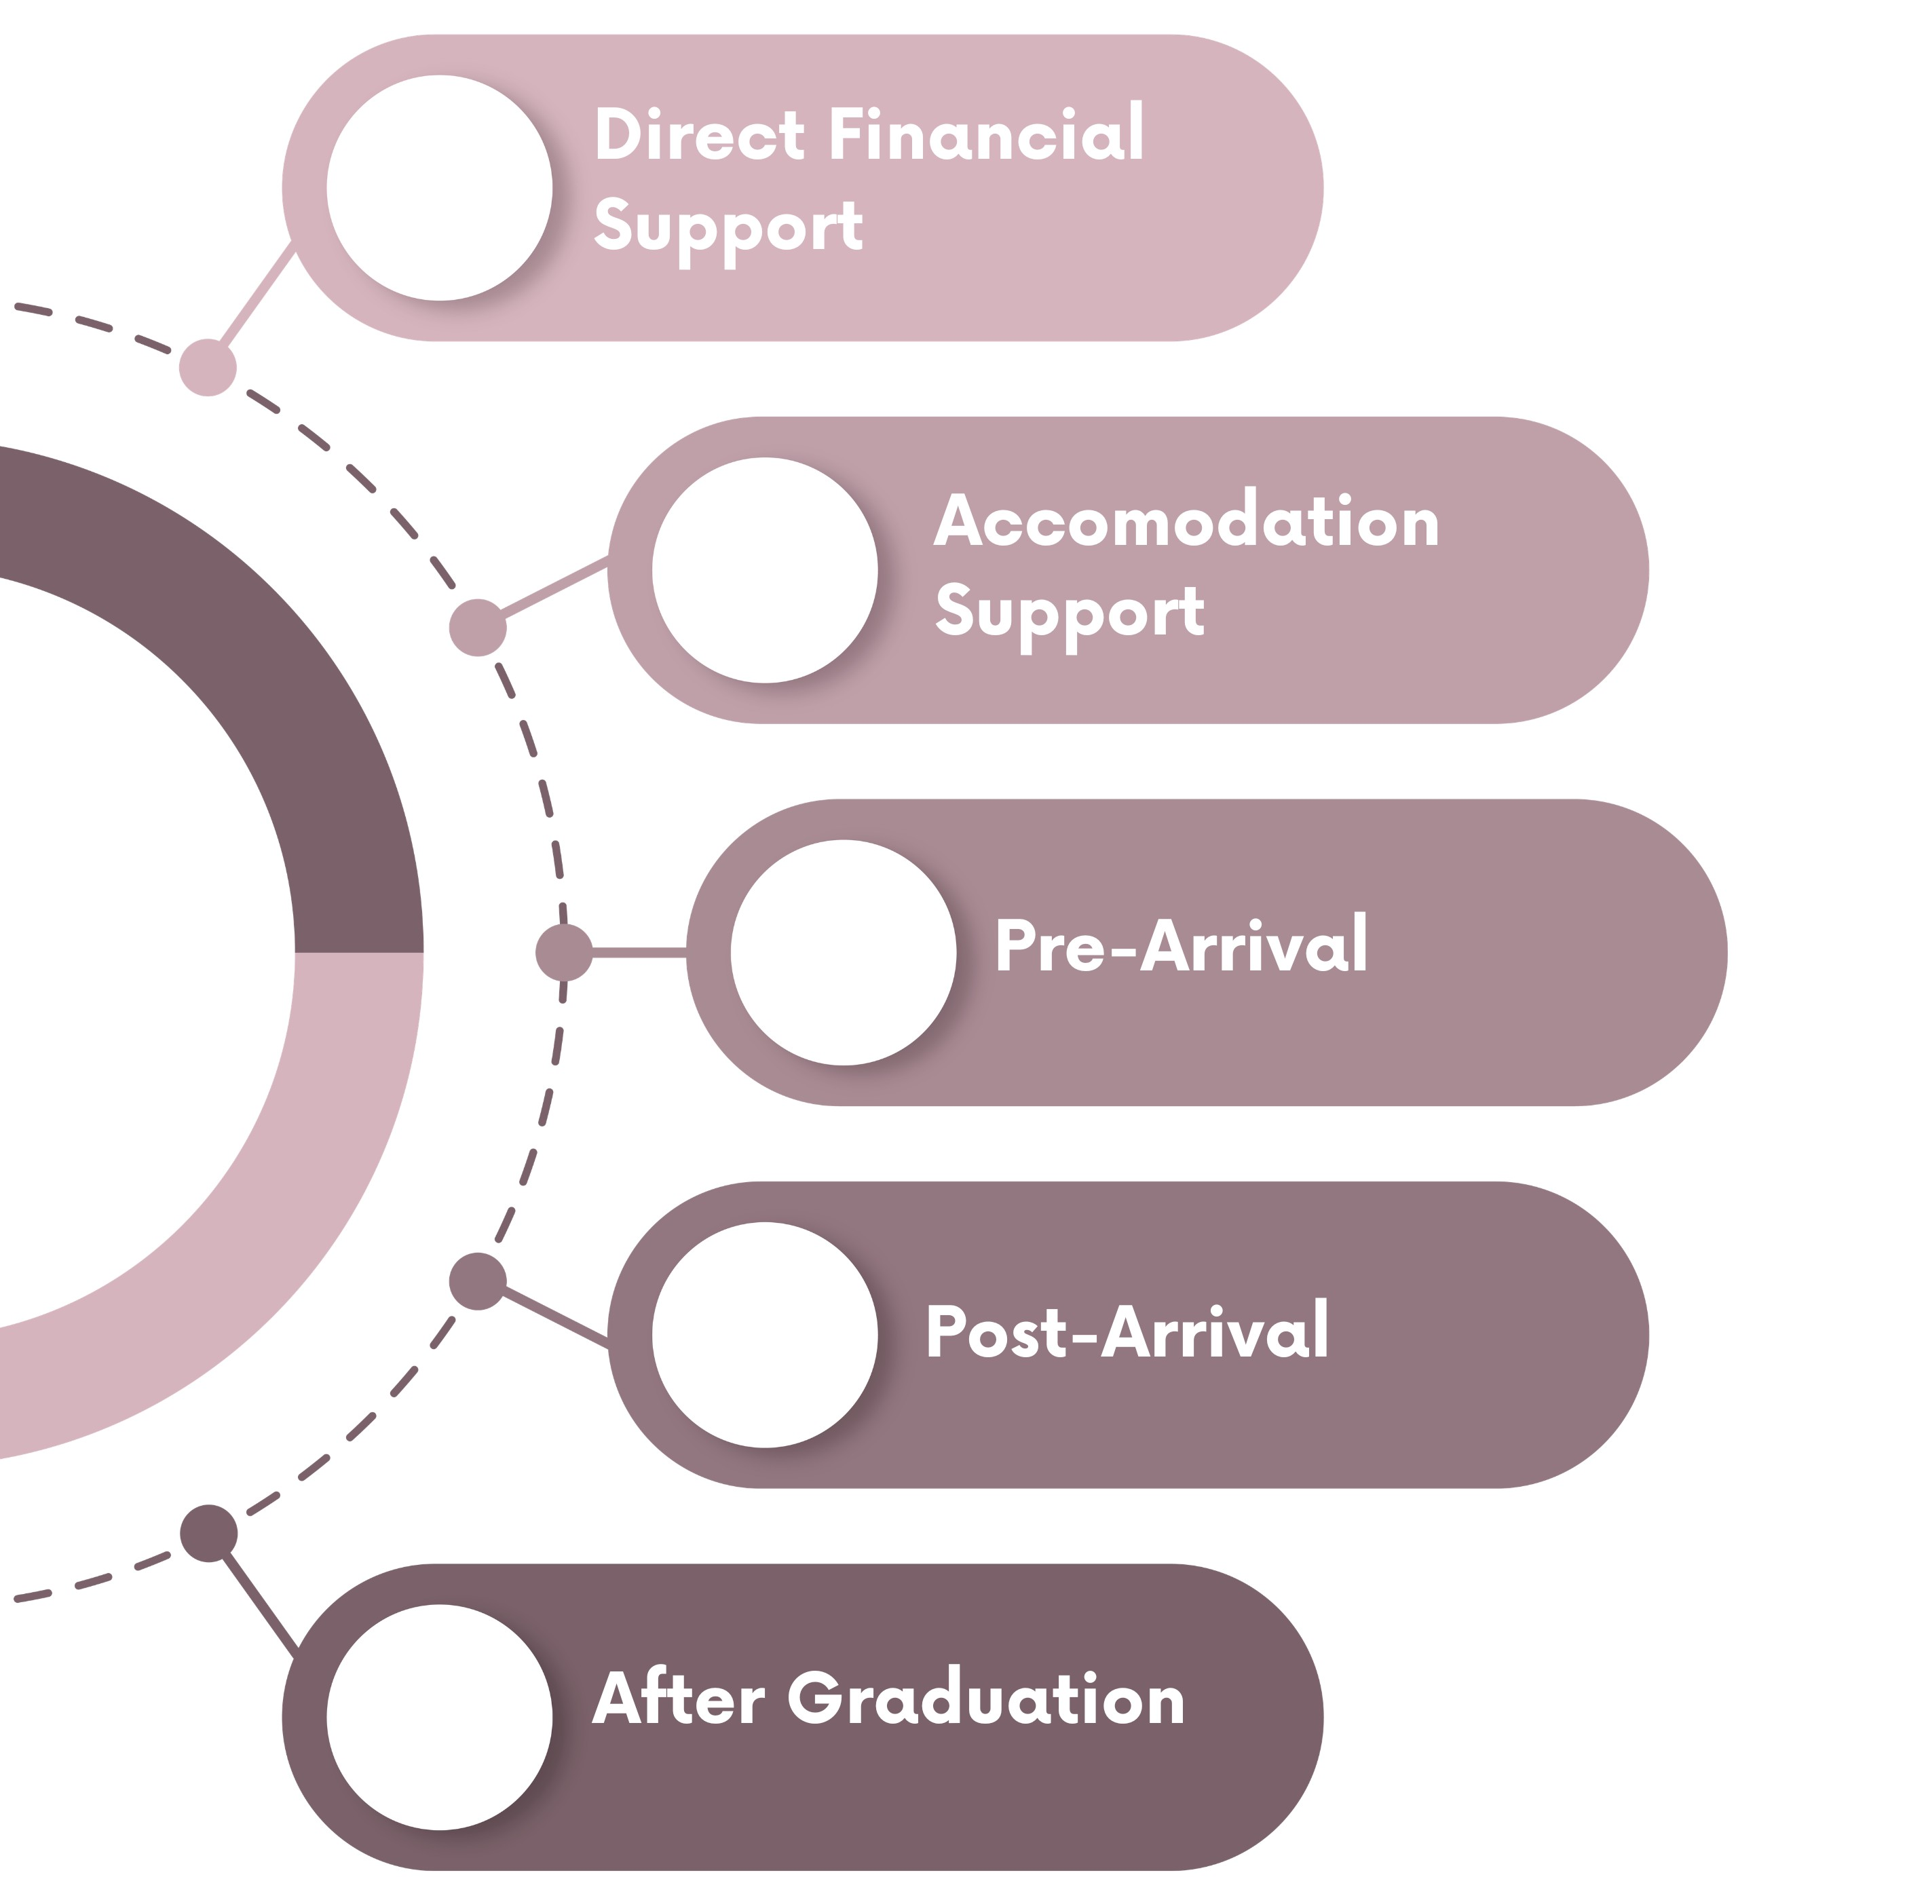
Key Areas of Support

Slide 12

Direct Financial Support
Durham Undergraduate Bursary Scheme (DUBS):
  Up to a maximum of £2,721 per year.
Independent Student Bursary:
  Year 1: £500 on arrival, £1,000 in summer. Total: £1,500.
  Year 2: £1,000 in summer. Total: £1,000
  Year 3: £500 at Graduation. Total £500
  Total: £3,000.
Accommodation Support:
  20% reduction in College accommodation fees (starting 2025-26): up to £2,555 per year.
Notes:
2026/27 Durham Undergraduate Bursary Amounts by Household Income. Importantly students do not need to apply for this scheme.
Household Income - Bursary Amount
Less than £30,000 - £2,721
Between £30,000 and £47,200 - £2,720 and £851
Between £47,201 and £62,377 - £714
Total financial support per student: £18,828 over a three-year degree (average £6,276 per year).

Slide 13
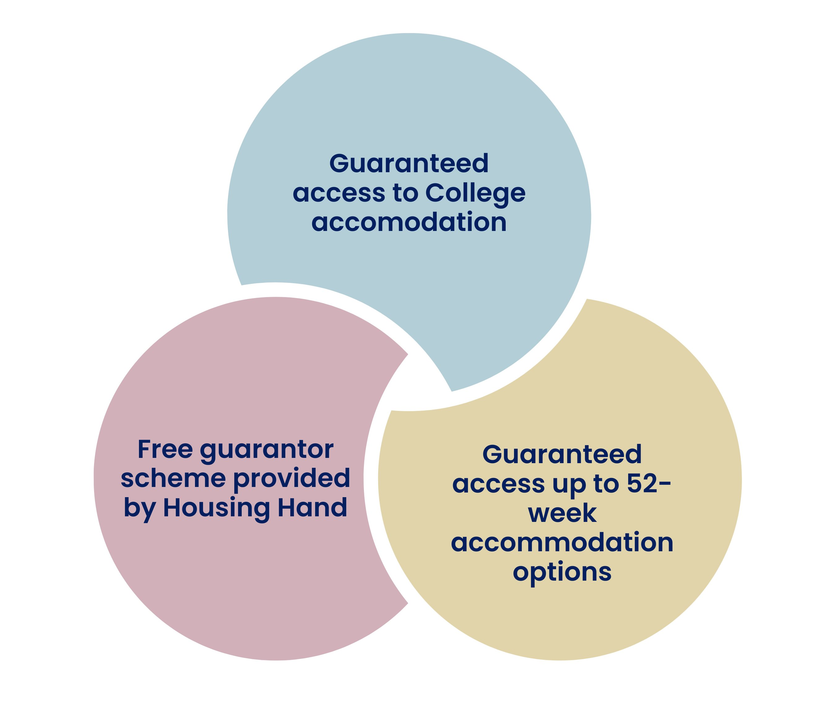
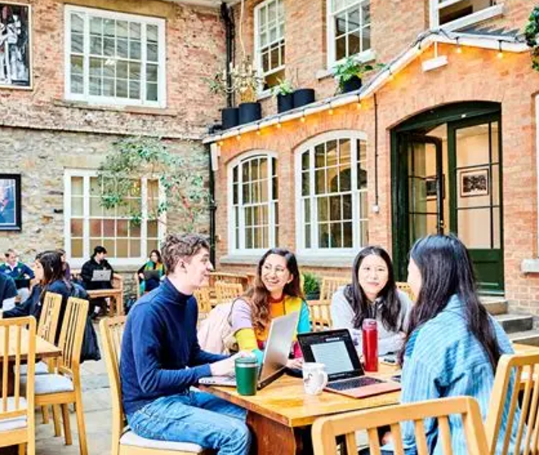
Accommodation Support
Notes:
Guaranteed access to College accommodation – this is something we offer as standard to all UG freshers, but we’ve also extended it to future years of study for EACE+ students.
Guaranteed access to 52-weeks accommodation – We issue standard licences to occupy plus a guaranteed extension period to a max of 52 weeks. The main advantage of issuing a standard licence to begin with is that we can allocate college membership to any college and all room types (catered/self-catered/studio) will be available, ensuring EACE+ students have choice. This also takes account of the fact that the majority of UG freshers still choose to live in private accommodation in friendship groups for their 2nd and future years. Most UG tenancies in the private sector begin in in July and the Fresher contracts end at the end of term. If there is a small gap between the end of term and the beginning of the new tenancy, colleges will be able to accommodate the student given that this will likely cover congregation week where final year students will be resident. If the student decides that they wish to remain in University accommodation for the whole of the year, then an appropriate extension can be granted. This can be for as long as the student needs up until the beginning of the new academic year (when a new contract can be issued).
Free Guarantor Scheme - Durham University is now working with a leading provider of rent guarantor services to enable students to access private sector accommodation where a UK guarantor is required. Whilst many students will ask parents or other relatives to act as UK guarantor for their tenancy, this is not always an option for some, particularly EACE+ students.

Slide 14
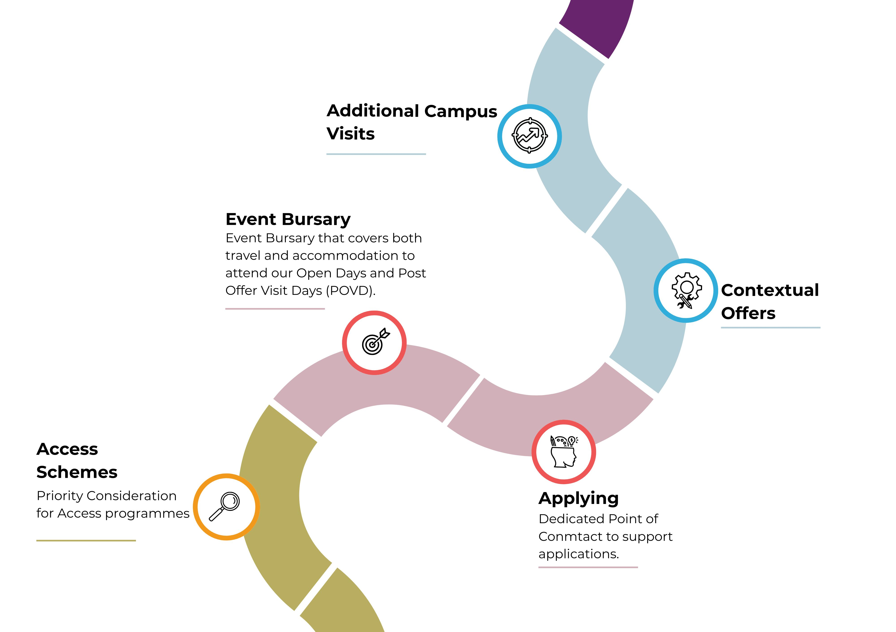
Pre-Arrival Support
Notes:
Priority consideration for access schemes - Durham runs a number of different access schemes, such as Destination Durham, Next Gen Durham, Space to Explore Potential (black-heritage only), Asian Access (Asian-heritage only) and Sutton Trust Summer Schools. EACE+ students are given priority consideration for these schemes. Each scheme is designed to enable students to develop a sense of understanding and belonging at Durham, improved academic confidence and self-efficacy…and also comes with a guaranteed contextual offer for those who complete the programme.
Event Bursary – EACE are entitled to an Event Bursary of up to £200 total to help with the cost of attending the Open Day (up to £150 travel, up to £50 accommodation). This is available multiple times, so someone attending an Open Day can also claim one for attending a POVD.
Contextual offers - A ‘contextual offer’ is an offer made to applicants who meet certain requirements at the University. You may be made a contextual offer at Durham if:
you've been eligible for free school meals (regardless of school type). We use data from UCAS which pulls together UK Government sources and data from the Independent Schools Council to identify eligible applicants.
or you meet two (or more) of the following criteria:
Your home address postcode is classified as Quintile 1 or 2 of POLAR4 LPN
Your home address postcode is classified as ACORN 5 or 6
Your current or most recently attended school is classified as a UK state school
You are care-experienced
You are an estranged student
Dedicated point of contact – we’re piloting a named contact for EACE+ students to ensure that we don’t pass them around multiple departments at the University. This was based on feedback from EACE+ students that they didn’t know who to contact and a faceless inbox didn’t give them confidence to reach out. The role of the named contact is to provide personalised support, reassurance and contact with EACE+ students and to advocate for change from within (by becoming fully immersed in the needs of those who reach out). We hope it will lead to improved institutional understanding and improved service design.
Additional campus visits – we also offer additional campus visits to enable prospective students to feel more comfortable before joining us.

Slide 15

Pre-Arrival Support
Named contact in the Careers and Enterprise Centre.
Named contact in Student Advice Team
Notes:
Named contact in the Careers and Enterprise Centre – we recognise that EACE+ students may feel more pressure to work during their studies (to support themselves financially). By having a named contact in our Careers and Enterprise Centre, they are able to access support quickly (and sometimes even before joining) to ensure they have employment opportunities that will not negatively impact their studies. Similarly, when they graduate there may be a pressing need to begin employment immediately. The named contact will work with them to ensure next steps are considered and they’re ready to secure their first role. This includes providing additional funds for travel to interviews, clothing for interviews and support to apply and prepare for interviews.
Named contact in Student Advice Team – EACE+ often have more complex needs than other students and a less-obvious support network. The Student Advice Team ensures they have a named contact who can help them with various elements of their journey with us; from providing pastoral support and care via their college, securing specific academic support with the department, working through personal life challenges (such as their physical or mental health), and everything in between. Having a named contact ensure there’s a personal relationship with someone who understands the specific needs of EACE+ students. Again, this understanding can be fed back into the University and lead to enhanced service design and support.

Slide 16
Post-Graduation Support
One-to-One Support
Business Start-up Support
Events
Online Resources
Through our CareersConnect platform, graduates can:
search for graduate jobs and internships
enrol on one of our e-learning Pathways
access resources including Graduates First, Student Circus, GoinGlobal and Alternative Guide to Postgraduate Funding
Notes:
One-to-One Support - We offer in-person and online appointments with our Careers Advisers where you can discuss your career plans, get feedback on applications and CVs, assessment centre and interview support, or discuss any other careers related questions you have.
Business Start-up Support - if you're interested in setting up your own business or being self-employed, you can access our specialist start-up support services. This includes start-up coaching sessions, workshops, funding opportunities, competitions, and networking events. Our Durham Venture School programme offers stipends, investment opportunities and mentoring.
Events - As a graduate, you can still attend our programme of on-campus and virtual careers and employer events.
Online Resources - Our online resources and digital learning tools provide comprehensive information and e-learning activities to support your career planning and applications, as well as access to vacancies and events.

Slide 17
Looking to the Future
Next steps to Enhancing our Support

Slide 18
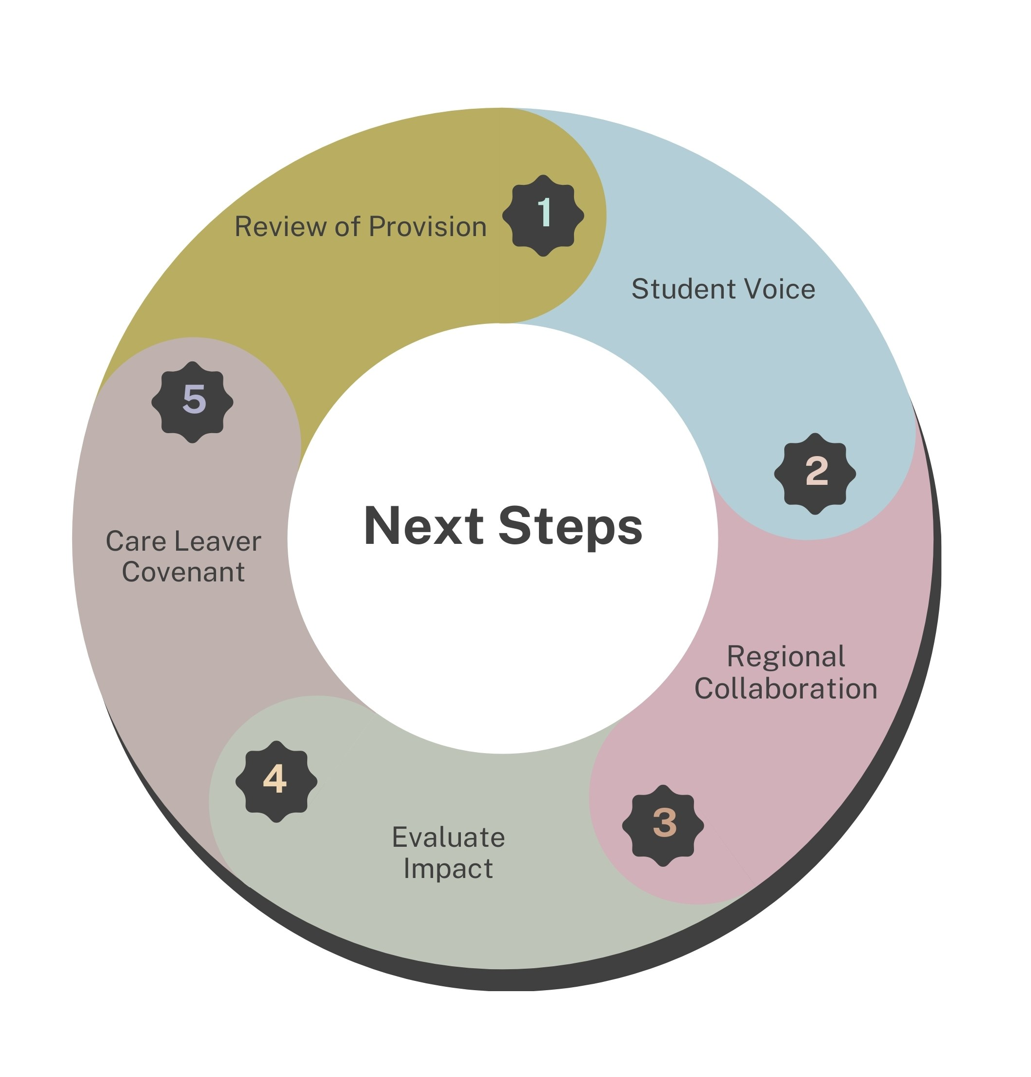
Looking to the Future
Process Review
  Student Support Services
  Colleges
  Student Finance
  DU Cares
Access UNEE
  Care Leaver Covenant

Slide 19
Thank you

Slide 20
Sarah Bishop and James Ward- Teesside University

Slide 21
From Sticky to Homely
Building welcoming environments through inclusion
Sarah Bishop
Assistant Director,
Communities, Culture and International (CCI)
James Ward
Assistant Director,
Strategy, Quality and Planning

Slide 22
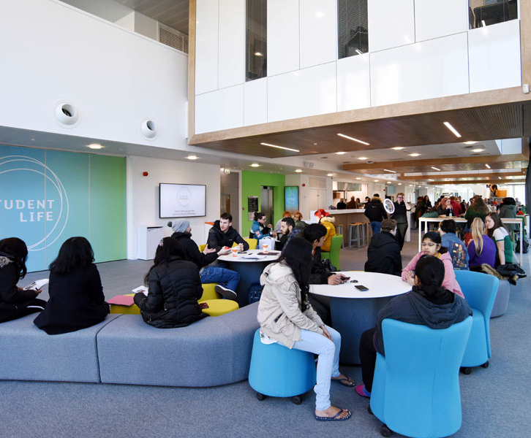
Outline
What actually is belonging?
Inclusion and accessibility
Design principles
Barriers and enablers

Slide 23
Belonging?

Slide 24


Social Connection
Identity Affirmation
A physical and digital environment where students choose to stay beyond their scheduled classes
Sense of value (self and academic)
Academic Inclusion
Notes:
Social Connection - Belonging includes feeling connected to peers, academic staff, and professional services, and experiencing meaningful interpersonal relationships. Regular, positive interactions help students feel noticed and supported, reducing isolation and disengagement. [files.eric.ed.gov], [mdpi.com]
Academic Inclusion - Students experience belonging when they feel intellectually respected and able to participate confidently in learning activities, assessments, and academic dialogue. Inclusive pedagogy and classroom climate are particularly influential here, echoing earlier work on classroom communities and student integration.
Identity Affirmation - Belonging is strengthened when students’ identities and backgrounds are recognised and valued, rather than marginalised. Large‑scale reviews show that students from under‑represented or minoritised groups often report lower belonging when institutional cultures implicitly privilege a dominant norm
Sense of value - At an institutional level, belonging refers to the feeling that “this university is for people like me”, supported by fair processes, transparent communication, and consistent support regardless of circumstances or background.

Slide 25
Belonging in the TU context
Sport
Campus Activity
Intramural leagues
Olympia Active taster sessions
Multi-format delivery (in person and online)
International transitions events include home students
Weekly FIKA and crafting sessions for decompression
Free Short Yoga and meditation classes
Lifestyle support and drop-ins
Community football activities
Community Engagement
Clinics
PAWS for Thought
Project work
Volunteering
Local services coordination
Female Fridays
Adventure for Wellbeing
Loan out of equipment (e.g. Table Tennis)
Shared events
Demographics of the student population
Time poor / Interest rich
Pressures and responsibilities
51% > 25 years | 50% from NE | 1:4 international
Cost of living | Part-time work | Re-engaging with on-site study
Childcare | Commuting | Multi-campus
Notes:
c.85% of TU students are at risk of experiencing an inequality of opportunity. Predominately due to socio-economic background but also a high proportion for students with a declared disability, first generation in HE etc. A focus of our APP strategy is to further increase access for marginalised students, and particularly those from global majority ethnicities, so building representation and belonging for students of colour in a meaningful way in a very White student population is also a challenge.
Belonging therefore is even more important for those who may not have the ‘traditional safety nets’ available to those with high levels of social capital.

Slide 26
Building Belonging
(Re)establishing campus memory

Slide 27
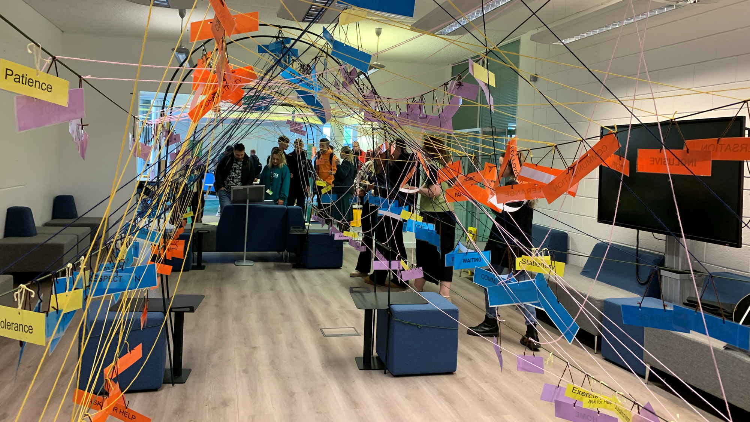
Deliberate design of support and interventions utilising:
Design principles:
  Personalisation and Choice
  Enjoyment
  Co-Creation
  Considered and Careful
Evaluation
Cultural relativism
Notes:
embrace personalisation and choice. Allowing students to see themselves and their interests in our developments. Offering flexible pathways, to boost autonomy and motivation.
encourage enjoyment. Creating a student experience that is rigorous yet fun, where curiosity and engagement is celebrated.
involve students as authors of their own experience rather than just consumers. Picking their own ‘route’ through co-creating design, delivery and evaluation at all stages of the student journey.
consider and care for our students beyond their grades. Adopting an approach that treats them as ‘whole people’ and

Slide 28
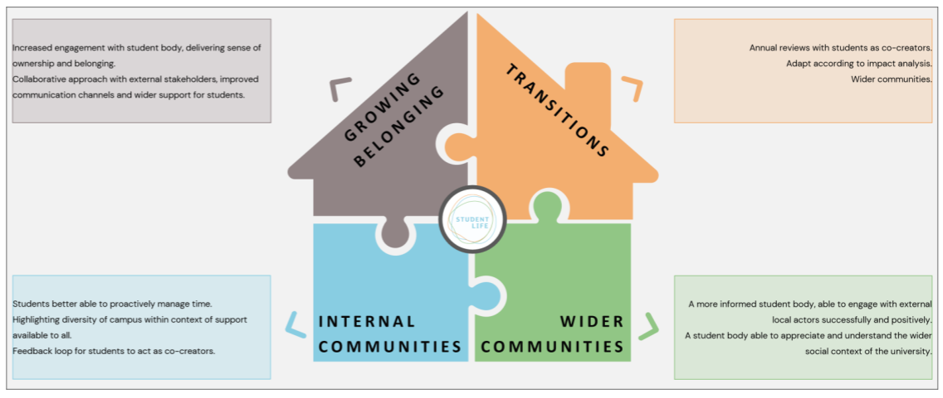
Belonging Framework
Increased engagement with student body, delivering sense of ownership and belonging
Enhanced collaborative approach with external stakeholders, more communication channels and wider student support
Annual reviews with students as cocreators
Adapt based on impact analysis
Link transitions support to wider communities
Students can better proactively manage time
Highlights diversity of campus with context of available support
Delivers feedback loop for students as cocreators
More informed student body able to engage successfully with local actors
Student body that understands and appreciates the wider social context of the university

Slide 29

Making it easy – Student Life
A one-stop shop which moved beyond physical co-location to enable seamless and de-stigmatised support.
Services delivered from this building range from IT to mental health and our TU Cares service for care experienced students.
+24 hour support
Notes:
Student Life is a unique and innovative approach to facilitating a single point of contact at Teesside University. Much more than just pulling services into a single place the model triages students to ensure they seamlessly navigate a route to support whilst being offered proactive additional opportunities to engage with our services.
This point of need service and our proactive initiatives are delivered through an impressive physical service based in the award-winning Student Life Building, the Library welcome desk and virtually through our sector leading utilisation of an enquiry management system.
Our concept delivers individual service specialisms in a person-centred way through a triage process which identifies need and ensures onward referral to specialist services. This removes the burden of multiple assessments on students and enables a holistic understanding of need.
Also starting to identify that unplanned or ad hoc interventions or activities need to be brief, engaging

Slide 30

2. Make it relevant
Campaigns and festivals
Specific evidence based interventions/support
Tailoring cross the student journey
Notes:
Student Life festivals are designed to run along sequential themes of becoming, belonging and thriving with differing aims ranging from orientation to the university, campus and location to trying new activities and meeting new people.

Slide 31




2. Make it inclusive
Access and Participation enabling belonging through addressing inequity.
TU Cares
Notes:
Our APP interventions are interwoven within the belonging framework. TU care package for care experienced students (ensures we meet the NERAP Covenant too).
First University in the North East to sign up to the Disabled Student Commitment – our key aim is to reduce the additional

Slide 32
Barriers, enablers and community recovery

Slide 33
Schools
Core CCI Activity
Student Journey and Student Success
Wider Student and Library Services
Multi-campus activity
Faith leadership and liaison
Transitions: In, Onward and progression
Student Union
Student Advocacy
Community Programmes
Volunteering
The Belonging Network
at Teesside

Slide 34
Reestablishing campus memory
Pandemic Hiatus
Few students on campus
New Arrivals
Student Life and the beginnings of campus memory
Flow of campus activity interrupted
Y1-3 UG and PG students new on campus
Campus discovery
Students arriving from different pandemic regulations
No campus flow
No pre-existing campus memory
Anxiety around re-integration
Long cycle to re-establish flow
Staff re-engaging on campus
Identifying good practice (Staff)
Integrate staff efforts to maximise impact
Student Life concept started in 2020 at Teesside
  Brings together student services
Good practice exists across the university
  Coordination of efforts
  The beginnings of a framework
Campus memory cycle takes six years to re-establish

Slide 35

Widening differences in expectations
Hostile media environment.
Marketisation of HE and ‘customer’ expectations.
Challenging labour market.

Slide 36




Belonging: A journey as unique as a snowflake
Identify your key themes:
- Demographics and pressures
- Settings and engagement opportunities
- Existing best practise/opportunities
Integrate and develop:
- Develop activity around what works well
- Identify additional support for other options
Review changes (internal and external) and coordinate
Embed and Expand:
-Expand established activities, respond to student feedback
- Build resilience through multiple small interventions
- Coordinate activities and highlight to wider institution
- Allow and support resituating of activity into wider student services structure
Establish a base:
- Create your first interventions, don’t be afraid to experiment
- Review and integrate other activity within the programme of events

Slide 37


Questions

Slide 38
The National Network for the Education of Care Leavers, NNECL, is the UK’s only organisation solely dedicated to transforming the educational outcomes of young people with experience of being in care.
www.nnecl.org
charity no 1180793

