Slide 1

NNECL Webinar
The Impact of Trauma on Learning
Notes:
Trainer notes:
Introduce the session and run through any housekeeping.

Slide 2

Interpersonal Safety
Be aware of your body sensations
Observe your feelings
Be curious
Be kind
Be gentle
We arrive with who we are, what we know and where we’re at…
Notes:
Trainer notes: This is a ‘health warning’ slide to be introduced gently without alarm

Slide 3
Family Privilege
Family Privilege is defined as the benefits, mostly invisible, that come from membership in a stable family. Most people cannot even imagine what life might be like without Family Privilege.
Family Privilege is an invisible package of assets and pathways that provides us with a sense of belonging, safety, unconditional love, and spiritual values. With Family Privilege, children observe parents or older siblings to see the effort it takes to be successful in life. Family Privilege provides the chance to hope and to dream.
Only as we recognise the power of Family Privilege can we begin to grasp how its absence hinders development.
Seita (2001)
Notes:
Trainer notes: Run through the outcomes and check if the group have any questions.

Slide 4
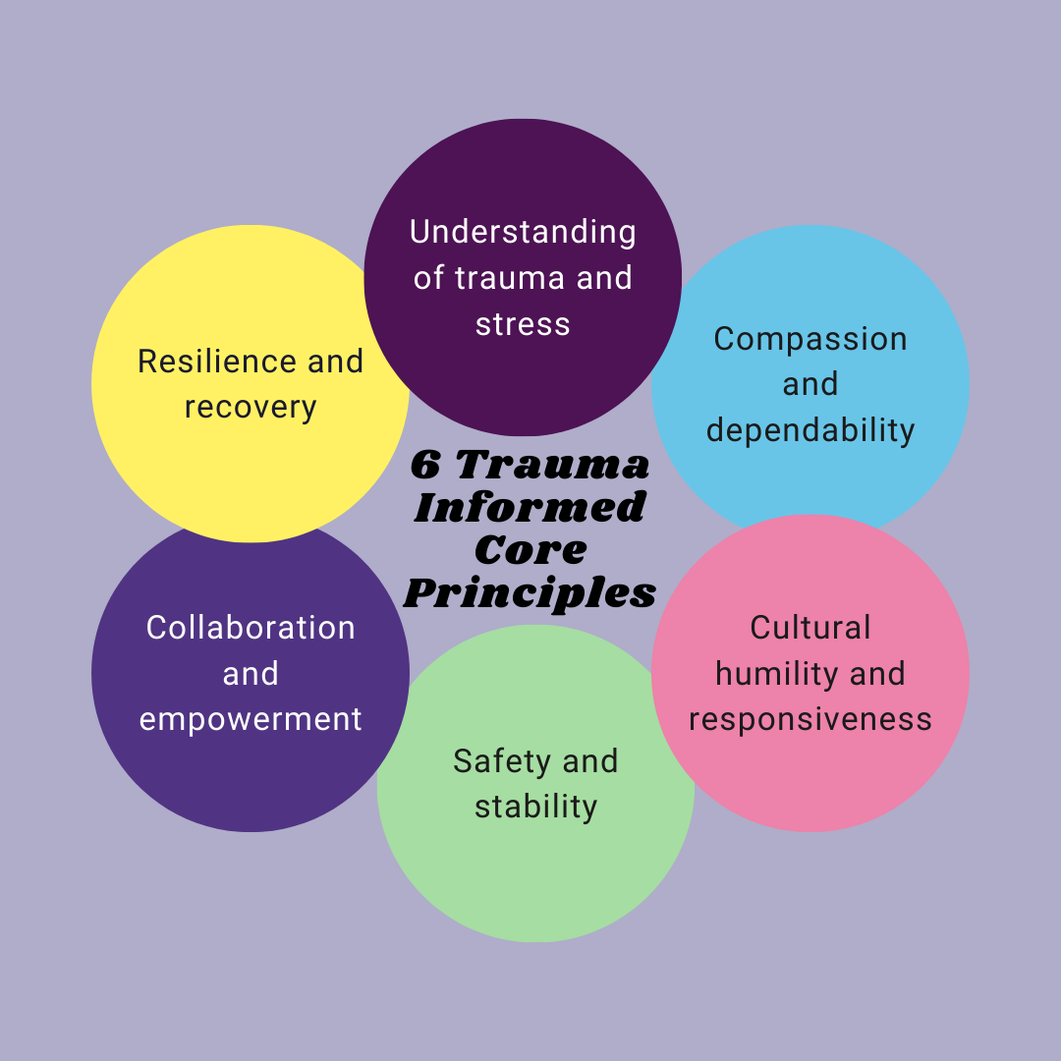

Trauma Informed Education and Nurture Principles
Ref: https://www.merseysidevrp.com/resources/trauma-informed-practice/
Ref:The Six Principles of Nurture (NurtureUK, 2020b, p.2)
Notes:
Trainer notes: Run through the outcomes and check if the group have any questions.

Slide 5
Care Experience and the Educational Journey
To provide context, out of the 12 million children living in England, just under 400,000 (3%) are known to the social care system at any one time (Park, 2022). Just over 82,000 of these children are ‘looked after’, under the legal guardianship of local authorities in England (National Statistics, 2022).
These young people are more likely than their peers to have experienced Adverse Childhood Experiences (Simkiss, 2019), experience poverty, be involved with criminal justice system (Gooch et al., 2022), become a teenage parent (Mezey et al., 2017), experience psychological distress or mental health issues (Adley and Kina, 2017), housing problems, and/or homelessness (Liabo et al., 2016).
They are also less likely to achieve academically in school, attend higher education (O’Higgins et al., 2017), or enter into stable employment (Gypen et al., 2017) than their non-looked-after peers.
Notes:
Trainer notes: Run through the outcomes and check if the group have any questions.

Slide 6
Further Sources of Help
Samaritans call 116 123 jo@samaritans.org.uk
Shout text 85258
Calm www.thecalmzone.net
Anxiety UK www.anxietyuk.org.uk
Beat www.beateatingdisorders.org.uk
NHS Every Mind Matters https://www.nhs.uk/oneyou/every-mind-matters/
Cruse Bereavement Support https://www.cruse.org.uk/
National Debt Line https://www.nationaldebtline.org/
Hub of Hope https://hubofhope.co.uk/
Education Support https://www.educationsupport.org.uk

Slide 7
References
Alderson, H. and Harrop, C. (2024), "Educating the Educator – Teaching Around Care Experience", McGovern, W., Gillespie, A., Brandon, T. and McInnes, A. (Ed.) Developing and Implementing Teaching in Sensitive Subject and Topic Areas: A Comprehensive Guide for Professionals in FE and HE Settings, Emerald Publishing Limited, Leeds, pp. 71-81. https://doi.org/10.1108/978-1-83753-126-420241007
Adley, N. and Kina, V. 2017. Getting behind the closed doors of care leavers: understanding the role of emotional support for young people leaving care, Child and Family Social Work, 22(1), 97–105.
Anna Freud (2020) Talking Mental Health. Available from: https://www.annafreud.org/schools-and-colleges/resources/talking-mental-health-animation-teacher-toolkit/
Association of Colleges (2020) Available from: https://www.aoc.co.uk/awards/blogs/the-power-young-people
Children and Young People’s Mental Health Coalition (2023) Available from: https://assets.publishing.service.gov.uk/government/uploads/system/uploads/attachment_data/file/1020249/Promoting_children_and_young_people_s_mental_health_and_wellbeing.pdf
Department for Education (2021) Promoting and Supporting Mental Health and Wellbeing In Schools and Colleges. Available from: https://www.gov.uk/guidance/mental-health-and-wellbeing-support-in-schools-and-colleges
Department for Education (2021) Education Staff Wellbeing Charter. Available from: https://assets.publishing.service.gov.uk/government/uploads/system/uploads/attachment_data/file/1034032/DfE_Education_Workforce_Welbeing_Charter_Nov21.pdf
Liabo, K., McKenna, C., Ingold, A. and Roberts, H. 2016. Leaving foster or residential care: a participatory study of care leavers’ experiences of health and social care transitions, Child: Care, Health and Development, 43(2), 182–191.
Kurian, Nomisha. (2022). School as Sanctuary: Trauma-Informed Care to Nurture Child Well-Being in High- Poverty Schools. 10.1007/978-981-16-2327-1_131-1.
Gooch, K., Masson, I., Owens, A. and Waddington, E. 2022. After care, after thought: the invisibility of care experienced men and women in prison, Prison Service Journal, 258, 4–12.
Mezey, G., Robinson, F., Gillard, S., Mantovani, N., Meyer, D., White, S. and Bonell, C. 2017. Tackling the problem of teenage pregnancy in looked-after children: a peer mentoring approach, Child and Family Social Work, 22(1), 527–536.
Sieta, J. 2001.Growing up without family privilege. Reclaiming children and youth 10(3) , 130-132
Simkiss, D. 2019. The needs of looked after children from an adverse childhood experience perspective, Paediatrics and Child Health, 29(1), 25–33.
O’Higgins, A., Sebba, J. and Gardner, F. 2017. What are the factors associated with educational achievement for children in kinship or foster care: a systematic review, Children and Youth Services Review, 79, 198–220.
Park, N. 2022. Estimates of the Population for the UK, England, Wales, Scotland and Northern Ireland. Available at: https://www.ons. gov.uk/peoplepopulationandcommunity/populationandmigration/ populationestimates/datasets/populationestimatesforukengland andwalesscotlandandnorthernireland
Trauma – informed co-production https://www.wypartnership.co.uk/application/files/6416/5104/5038/West_Yorkshire_Trauma_Informed_Co-Production_Guidance_April_22.pdf

