Slide 1


NNECL webinar:
Using data to transform education outcomes
Thursday 1 May 2025

Slide 2
Upcoming webinars
NNECL Quality Mark and submission process – 13 May
Nutrition, mental wellbeing and education for learners with care backgrounds – 21 May
Both are open for booking
14
22%
71%
£660
60%

Slide 3

Todays webinar is lead by Matthew Cooke, Virtual School Head for Suffolk County Council. He is dedicated to improving the educational experiences and outcomes for all care experienced children and children with a social worker. In this role, Matthew collaborates with education and social care partners to ensure these children receive optimal opportunities in their schooling. He also leads an initiative to support the employment of care leavers, known locally as ‘The Family Business’. Matthew has been an active member of the National Association of Virtual School Heads (NAVSH), having served as its immediate past chair. His leadership within NAVSH reflects his commitment to addressing systemic challenges in children's social care and advocating for the educational needs of vulnerable pupils, particularly in the post-pandemic landscape. .

Slide 4
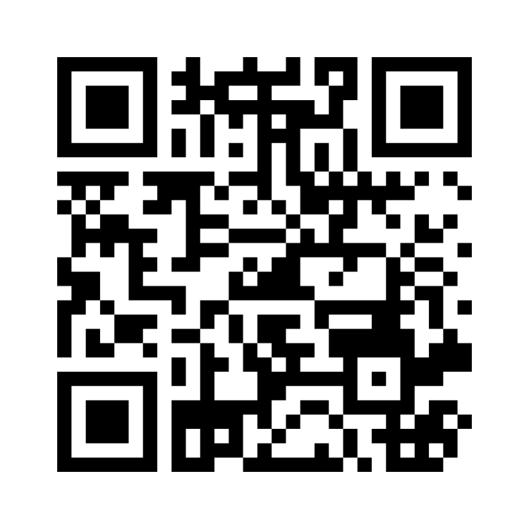
Super quick evaluation

